Slide 1
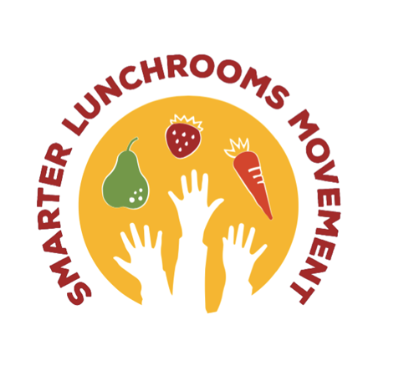


Smarter Lunchrooms Movement
Part 1 Training

Slide 2
Agenda
What is the Smarter Lunchrooms Movement?
Foundations
Principles
When should you use SLM?
The LIA’s Role
Step 2: Plan it!
  Action Planning Tool
Step 3: Do it!
Community Engagement
No Time to Train
📝

Slide 3

What is the Smarter Lunchrooms Movement?
“A nationwide movement based on proven strategies for nudging students to select and eat the healthiest foods in the school lunchroom.”
– www.smarterlunchrooms.org
Notes:
What is the Smarter Lunchrooms Movement? It’s A nationwide movement based on proven strategies for nudging students to select and eat the healthiest foods in the school lunchroom. For the AZ Health Zone, this is an evaluation tool you can use to improve lunchtime experiences for youth and adolescents in K-12 settings!

Slide 4

4-Step Cycle of Change
Spot it!
  This is your first use of the Smarter Lunchrooms Movement Scorecard.
Plan it!
  Review your scorecard results and recommendations, and plan the changes you’d like to make in the lunchroom.
Do it!
  Implement the changes!
Prove it!
  Re-assess the lunchroom with the scorecard and track your improvement! Don’t forget to celebrate the new changes and progress you’ve made!
The SET can support you with Spot it! and Prove it! While the SIT supports you with Plan it! and Do it!
Notes:
The smarter lunchrooms movements operates as a four-step cycle of change.
Step 1. Is Spot it! This is the first use of the smarter lunchrooms movement scorecard.
Step 2. Is Plan it! In this step, AZ Health Zone local implementing agencies review the scorecard results and recommendations sent from the state evaluation team. After reviewing the results with your site partners, community, or other stakeholders, you can start planning the changes you’d like to make in the lunchroom. We’ll talk more about this later.
Step 3. Is Do it! Your site partners should implement the planned changes! They made need support from you in this area. We will cover this later in the training.
Step 4. Prove it! Re-assess the lunchroom with the scorecard and track your improvement! Don’t forget to celebrate the new changes and progress you’ve made!
The SET (short for state evaluation team) can support you with steps 1 and 4, spot it and prove it! The SIT (short for state implementation team) can support you with steps 2 and 3, Plan it and do it! Keep that in mind when you need technical assistance in the future.

Slide 5
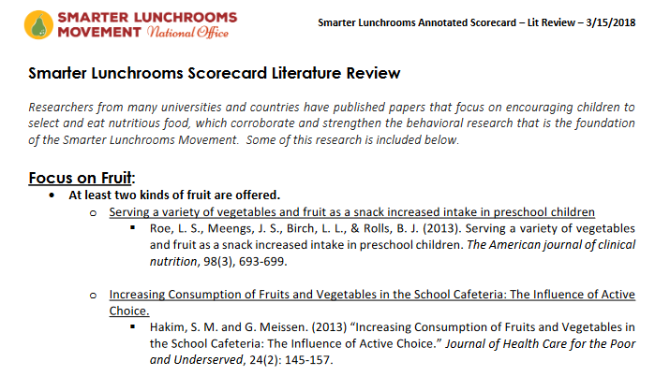
What is The Smarter Lunchrooms Scorecard, Arizona Version?
60 items
8 sections
Hardcopy or online
Evidence-based
Notes:
You might be curious about the Smarter Lunchrooms scorecard, especially now that we have an Arizona Specific version! Our evaluation team worked with Smarter Lunchrooms movement creator, Adam Brumberg, to help us update the scorecard to meet the needs of schools across Arizona. The scorecard has 60 items, 8 sections, is available in a hardcopy or digitally, and is evidence based! On the right you can see just a few of the studies that support the support the smarter lunchrooms movement, and there are additional studies available that support the new changes. For more information on the studies, reach out to Youth & Adolescent systems specialist or the the state evaluation team specialist.

Slide 6
Smarter Lunchrooms
Movement
Foundations

Slide 7
Smarter Lunchrooms Movement Foundations
Brings evidence
from the fields of:
Economics
Marketing
Psychology
Understanding of practices from these three fields can transform the school lunchroom to reduce food waste and increase consumption.
Notes:
The foundations of the smarter lunchrooms movement brings evidence and practices from the field of economics, marketing, and psychology. Understanding of practices from these three fields can transform the school lunchroom to reduce food waste and increase consumption. This is relevant because it aligns perfectly with AZ Health Zone youth & adolescent systems goals of improving nutrition and food access and creating comprehensive, self-sustaining policy, systems, and environment changes.

Slide 8
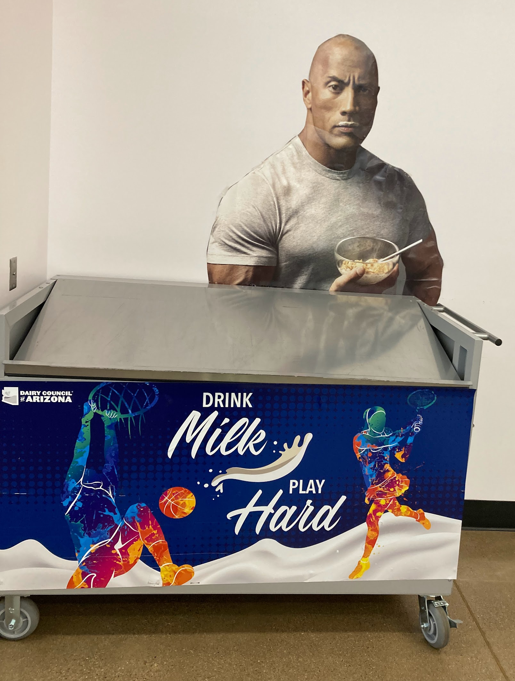
A Smarter Lunchroom…
“Nudges” choice
Increases Consumption
Increases sales
Maintains choice
Uses low cost or free changes
Notes:
You might be asking yourself, “how exactly do these foundations translate into practice?” andI am going to tell you!
A smarter lunchroom “nudges” students to make beneficial choices
It increases consumption of food, especially produce
It increases lunchroom sales, especially through reimbursable meals
It maintains choice
And it uses low cost or free changes to the lunchroom room and the school’s food environment.

Slide 9
Behavioral Economics
What does that have to do with a school lunchroom?
“...combines psychology with economics in order to try and better understand how humans actually act instead of how they should act. This means taking into account factors like emotions, beliefs, cultural influences and cognitive biases, all of which cause humans to deviate from straightforward rationality.”
-The Decision Lab
Notes:
How does a smarter lunchroom accomplish all of those great tasks?! It’s through the practice of behavioral economics, which combines psychology with economics in order to try and better understand how humans actually act instead of how they should act. This means taking into account factors like emotions, beliefs, cultural influences and cognitive biases, all of which cause humans to deviate from straightforward rationality.

Slide 10
Behavioral Economics
If I look more attractive, more kids will put me on their plates.
Basically, behavioral economics is the study of how environmental cues affect how people select and consume food.
Notes:
Basically, behavioral economics is the study of how environmental cues affect how people select and consume food

Slide 11
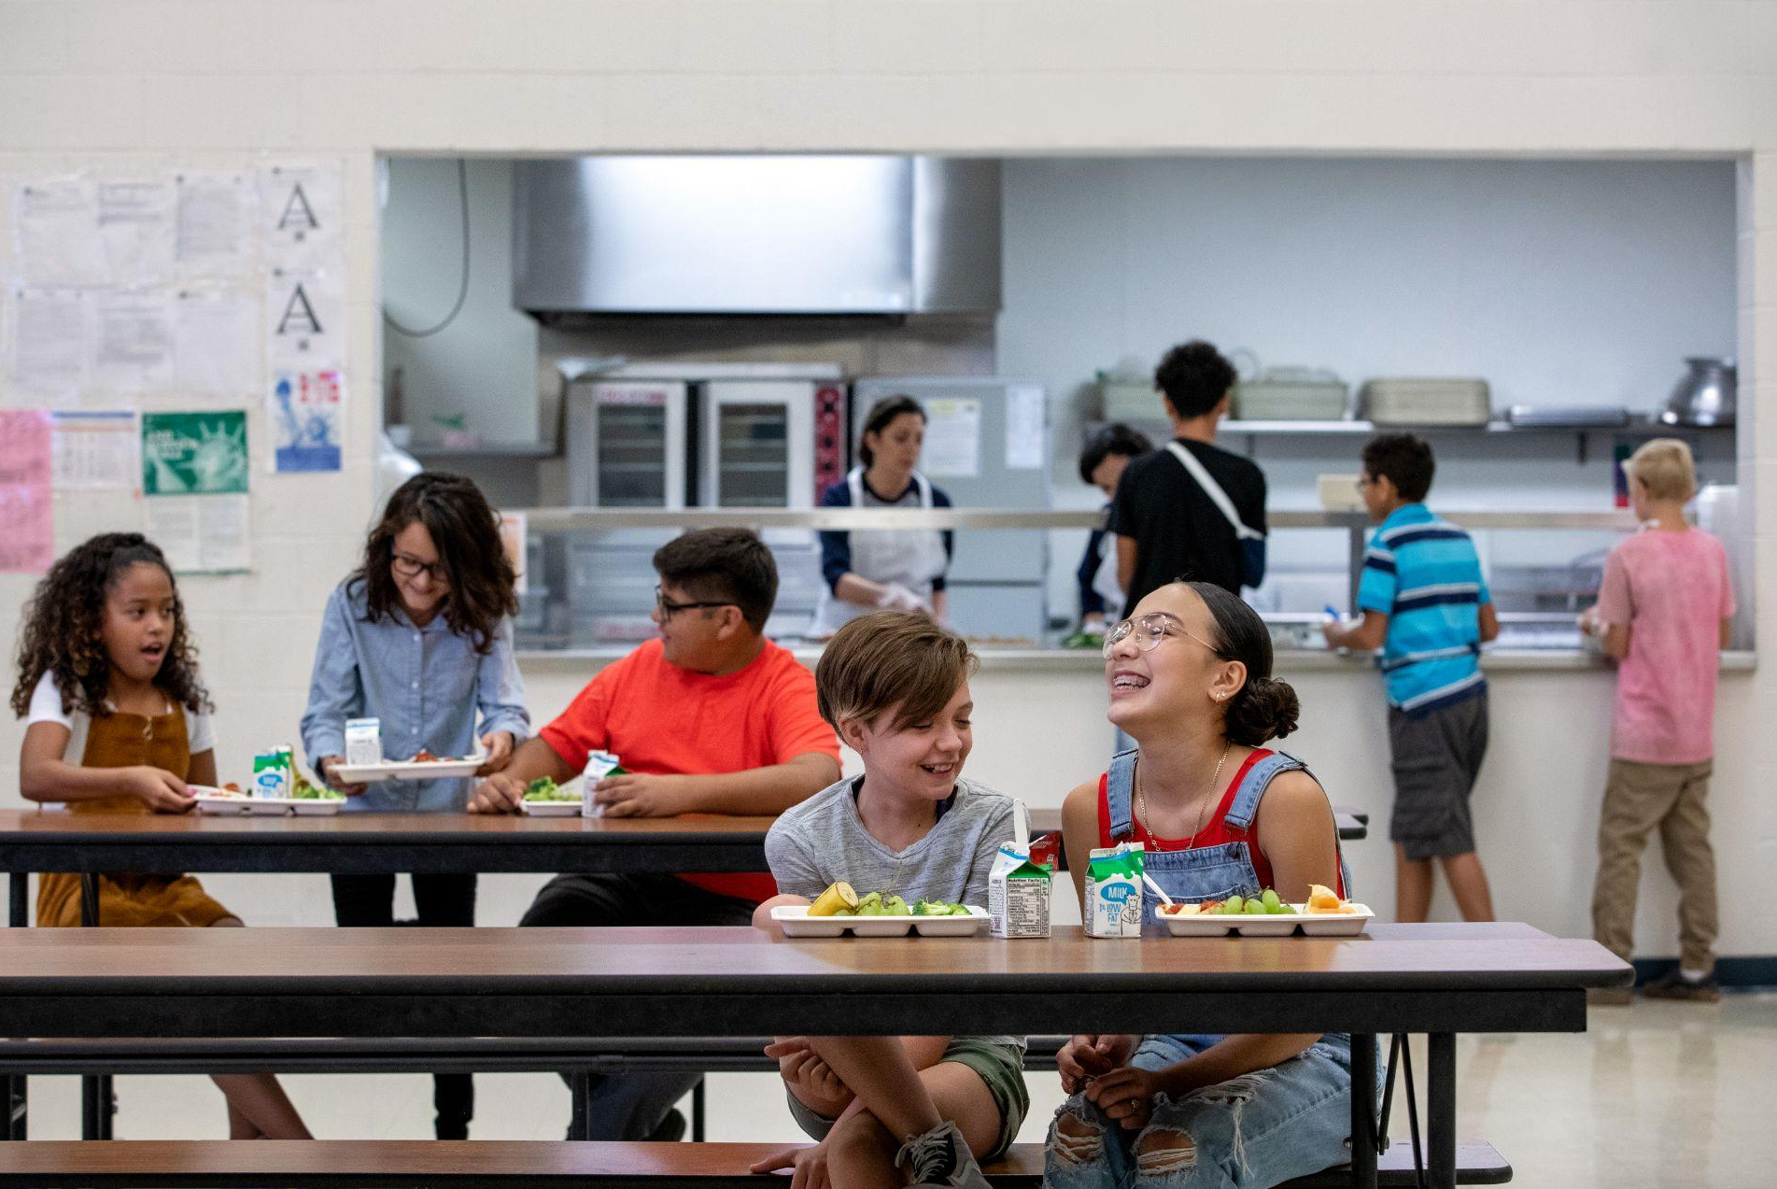
The Smarter Lunchrooms Movement assumes that many food choices are:
Automatic
Influenced by the social & physical environment
Made in a HOT STATE, when we are more susceptible to environmental cues
Notes:
To better understand the psychology of how choices are made, we need to look at states of thinking. First off, in the Smarter lunchrooms movement, there is an assumption that food choices are automatic, influenced by the social & physical environmen,t AND made in a hot state, when are more susceptible to environmental cues.

Slide 12
Right now, are you…
Hungry
Tired
Stressed
Distracted
Satiated
Rested
Relaxed
Focused
Hot State
Cold State
Notes:
Not familiar with the concept of a hot state? Well let’s look at some characteristics! If you are hungry, tired, stressed or distracted you are in a hot state which influences your decision making.
Alternatively, if you are satiated, rested, relaxed, and focused your decision making is made in a cold state!

Slide 13
Hot State
Cold State
Taste
Convenience
Appeal
“Is this going to make me feel good right now?
Nutritional content
Price
Value
“Is this good for my energy level later on?”
Notes:
When we are in a hot state, which can essentially be a state of distress or feeling frazzled or ungrounded, you are more likely to make food choices based on taste, convenience, appeal, or the idea that the food you are choosing will make you feel good immediately.
If making decisions in a cold state, when you feel grounded and good, you are more likely to focus on nutrition content, price, value, and if the food might be good for you energy level later on.
Here are some questions for you: was your last food choice made from a hot state, or cold state? Will you make your next food choice from a hot state or cold state?

Slide 14
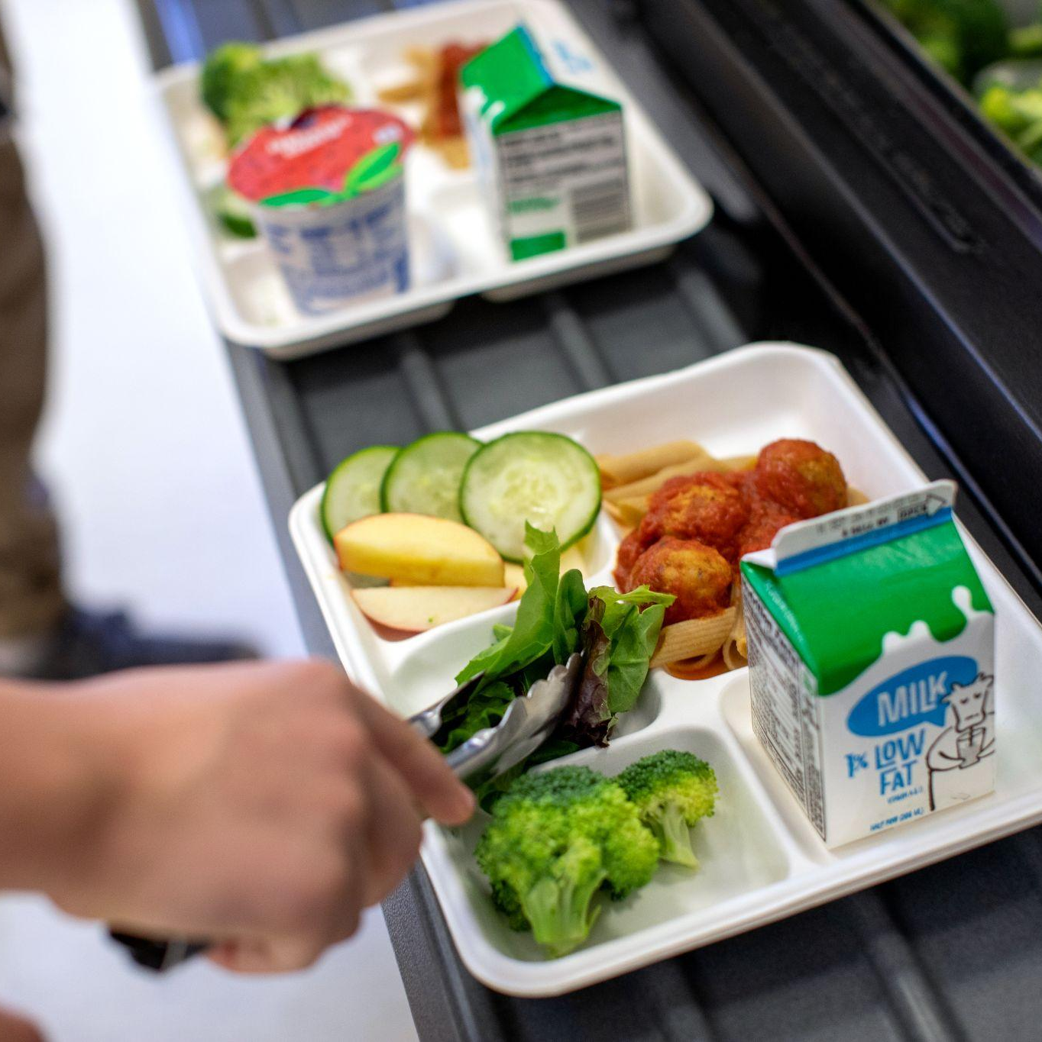
Choice Architecture
Kids, when given a choice between carrots and celery ate 91% of their choice versus 69% when they didn’t have a choice.
In Conclusion….give kids choices!

Slide 15
Elements of Choice Architecture
Framing a decision to prompt a certain response
  “Nudging”
Creates satisfaction about a decision
  “Owning it”
Often students don’t even know they are being influenced

Slide 16
Smarter Lunchrooms Principles
Notes:
Now, we are going to dive into the principles of smarter lunchrooms! This will help us understand why and how we implement smarter lunchrooms strategies.

Slide 17
Six Smarter Lunchrooms Principles
Don’t forget to apply your Trauma Informed lens!
Functional portions
Increase convenience
Improve visibility
Enhance taste expectation
Utilize suggestive selling
Set smart pricing strategies
Notes:
There are Six Smarter Lunchrooms Principles -
Functional portions
Increase convenience
Improve visibility
Enhance taste expectation
Utilize suggestive selling
Set smart pricing strategies
Within all of these principles, don’t forget to apply a trauma informed lens to align this work with the foundational principles of AZ Health Zone.

Slide 18
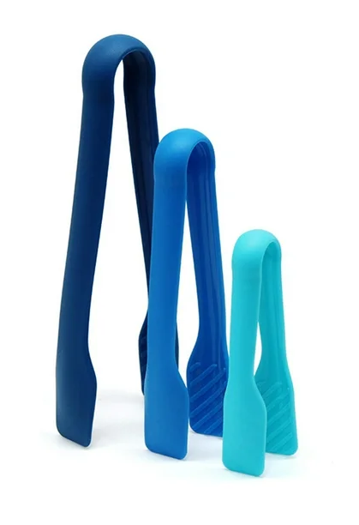
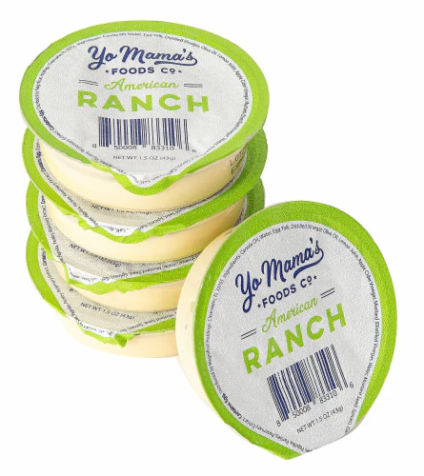
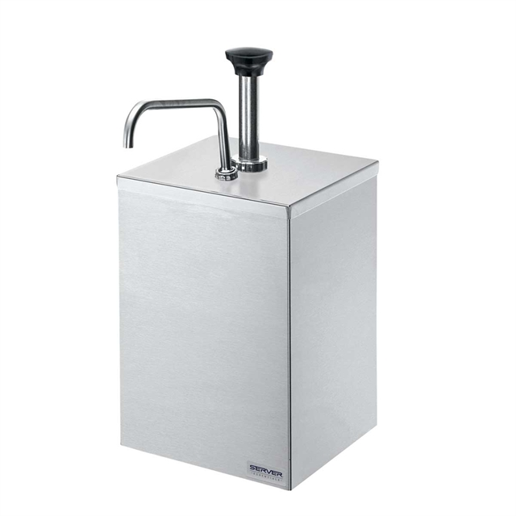
Functional Portions
Have the correct size serving utensils available for self serve for various age groups.
Have pre-packaged items available in the correct portion/serving size
Provide sliced/chopped produce and whole produce options
Notes:
Functional Portions
Have the correct size serving utensils available for self serve for various age groups.
Ex. Kinder-3rd might need different sized utensils in comparisons to middle and high schoolers based on functionality and motor-skills.
Have pre-packaged items available in the correct portion/serving size
This creates ease of flow for students in the lunch line, while ensuring they get a full serving!
Provide sliced/chopped produce and whole produce options
Options are great! Remember, it’s easier for littles to eat sliced/chopped fruit than large whole fruits, which are easier for older students.
In additional to the above, creating functional portions can help decrease lunchroom waste!
Tong image: https://www.google.com/url?sa=i&url=https%3A%2F%2Fbusiness.walmart.com%2Fip%2FBig-Sale-Piaybook-Kitchen-Food-Plastic-Tongs-Set-X-3-Three-Different-Sizes-For-Cooking-BBQ-Holding-Bread-Serving-Ice-Fruits-And-Easy-To-Hold-Manipula%2F8206752523&psig=AOvVaw25TAC0a-Kynu3f5sVpdcA5&ust=1734044885253000&source=images&cd=vfe&opi=89978449&ved=0CBQQjRxqFwoTCKCb_-fqoIoDFQAAAAAdAAAAABAE
Ranch: https://www.google.com/url?sa=i&url=https%3A%2F%2Fwww.picknsave.com%2Fp%2Fyo-mama-s-foods-ranch-salad-dressing%2F0071671514302&psig=AOvVaw3fVO7u4WPW7bNRaFbgBszL&ust=1734045083953000&source=images&cd=vfe&opi=89978449&ved=0CBQQjRxqFwoTCLCLw73roIoDFQAAAAAdAAAAABAE
Condiment Pump: https://www.google.com/url?sa=i&url=https%3A%2F%2Fserver-products.com%2Fequipment%2Fpumps%2Ffood-container-pumps%2Fvariants%2F67580.htm&psig=AOvVaw0r4_rEx15av5kxMSI_ym1h&ust=1734045503044000&source=images&cd=vfe&opi=89978449&ved=0CBQQjRxqFwoTCKC_ioTtoIoDFQAAAAAdAAAAABAK

Slide 19
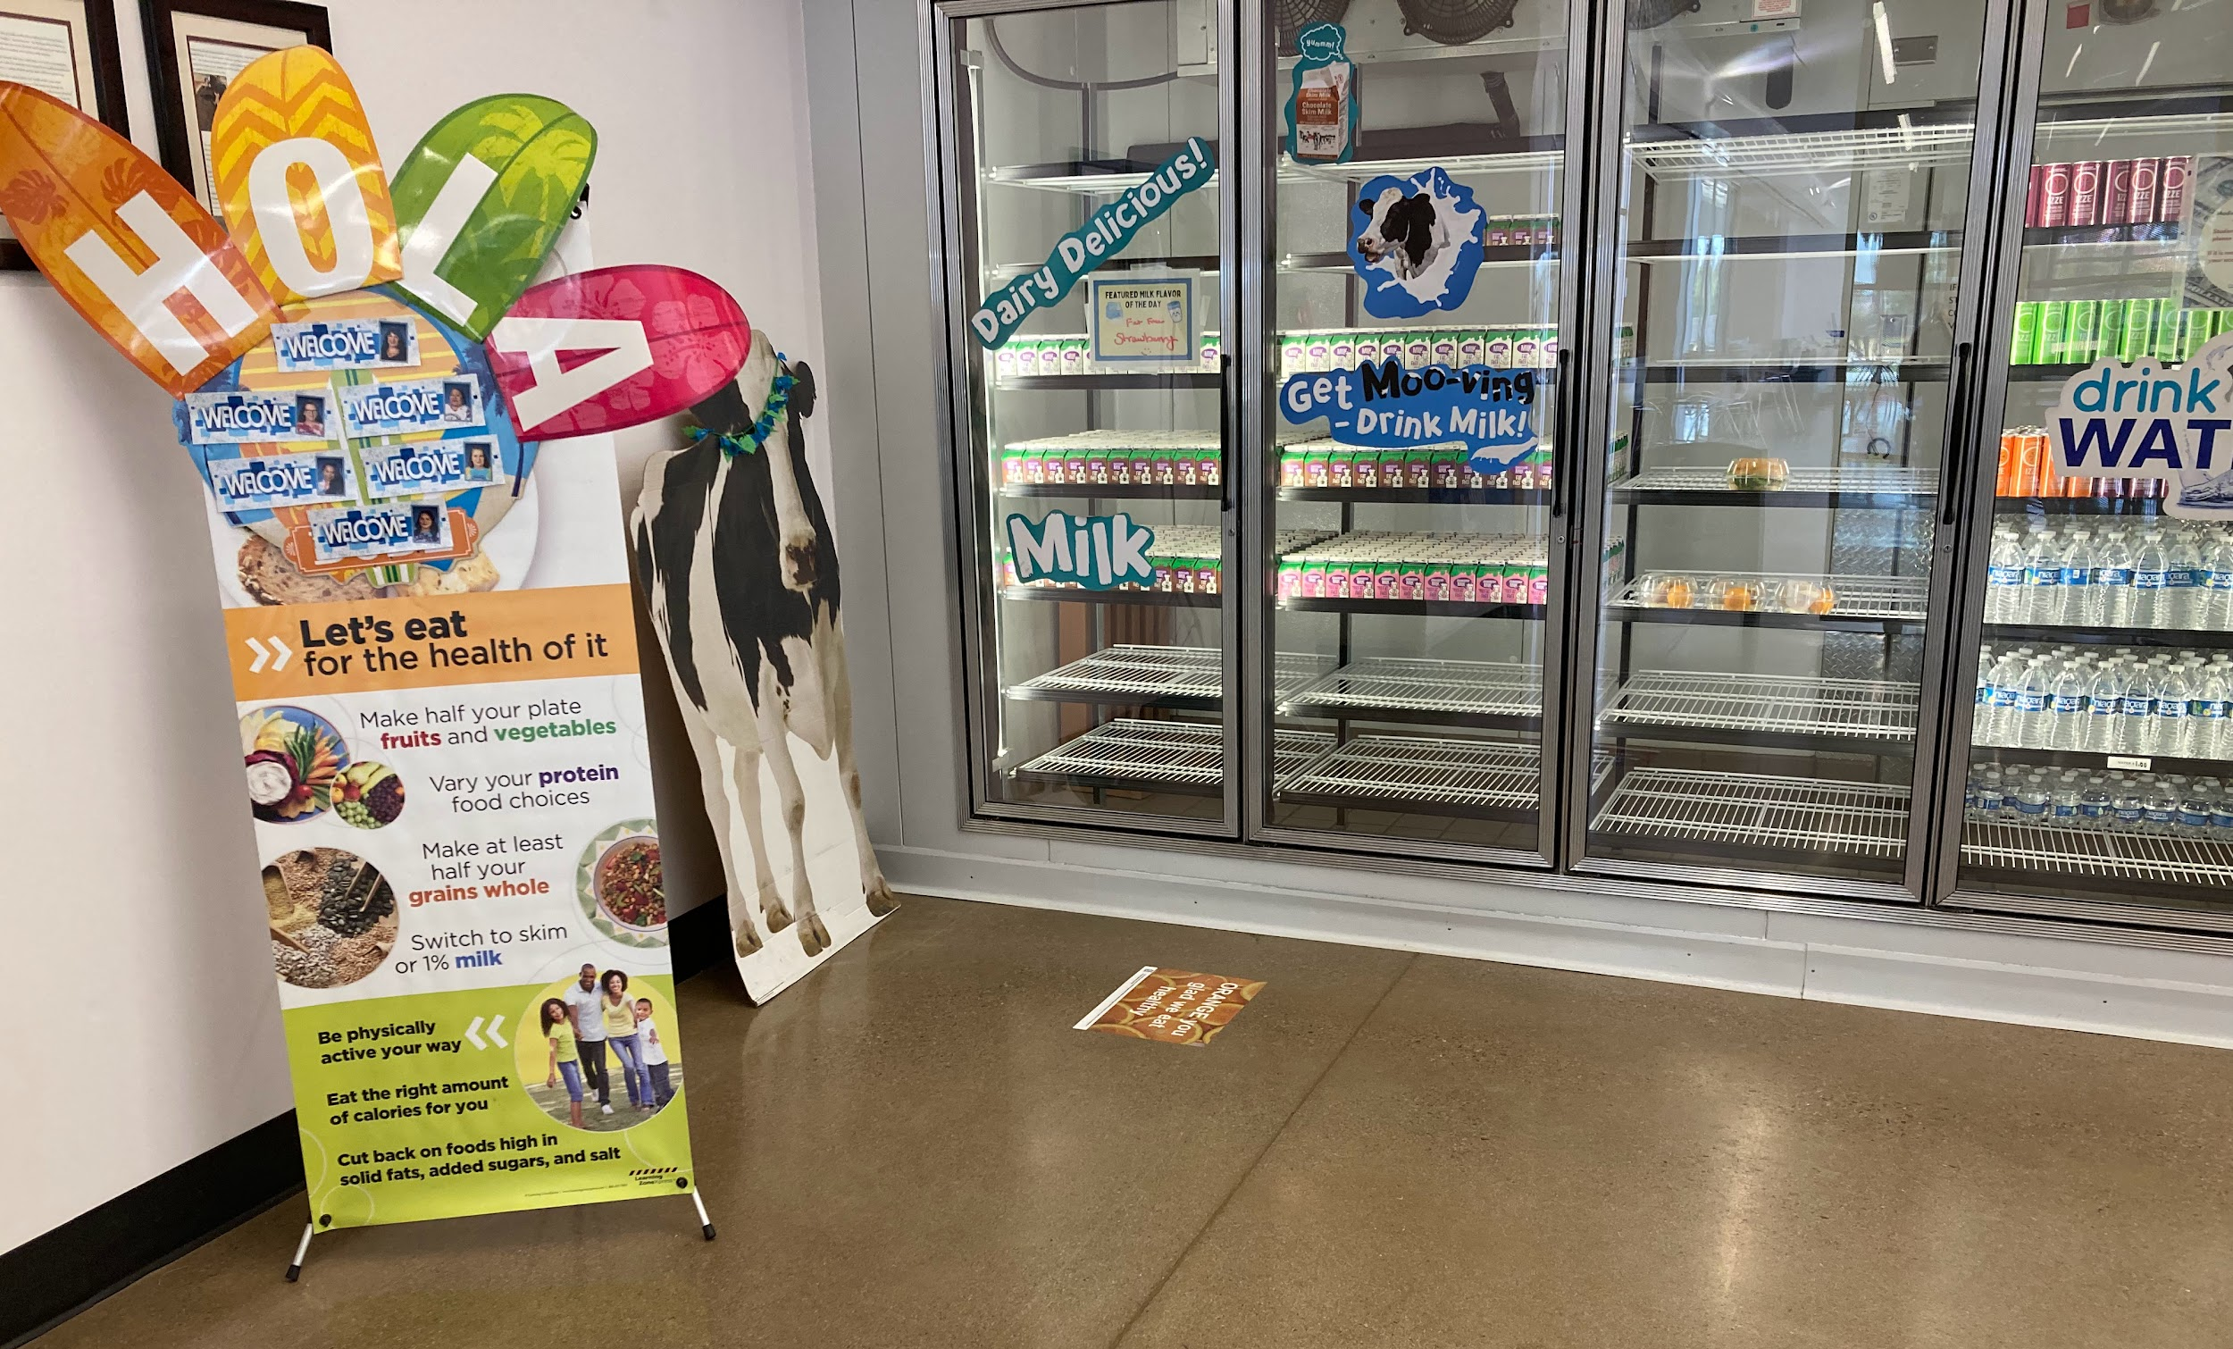
2. Increase Convenience
Increase convenience to students by reorganizing items
“Lonely” items are less likely to be selected.
Decrease convenience of items you don’t want picked by putting them behind the cashier so students have to ask for them.
Notes:
The next topic is very important - Increase convenience! Many people are driven to make choices based on how convenient they are.
Increase convenience to students by reorganizing items
Place milk, water, or desired beverage in front
Display more of the desired beverages
“Lonely” items are less likely to be selected.
Decrease convenience of items you don’t want picked by putting them behind the cashier so students have to ask for them.
When something is easy to reach and looks plentiful, students are more likely to pick those items. Items that are more difficult are less likely to be chosen as people generally prefer convenience

Slide 20
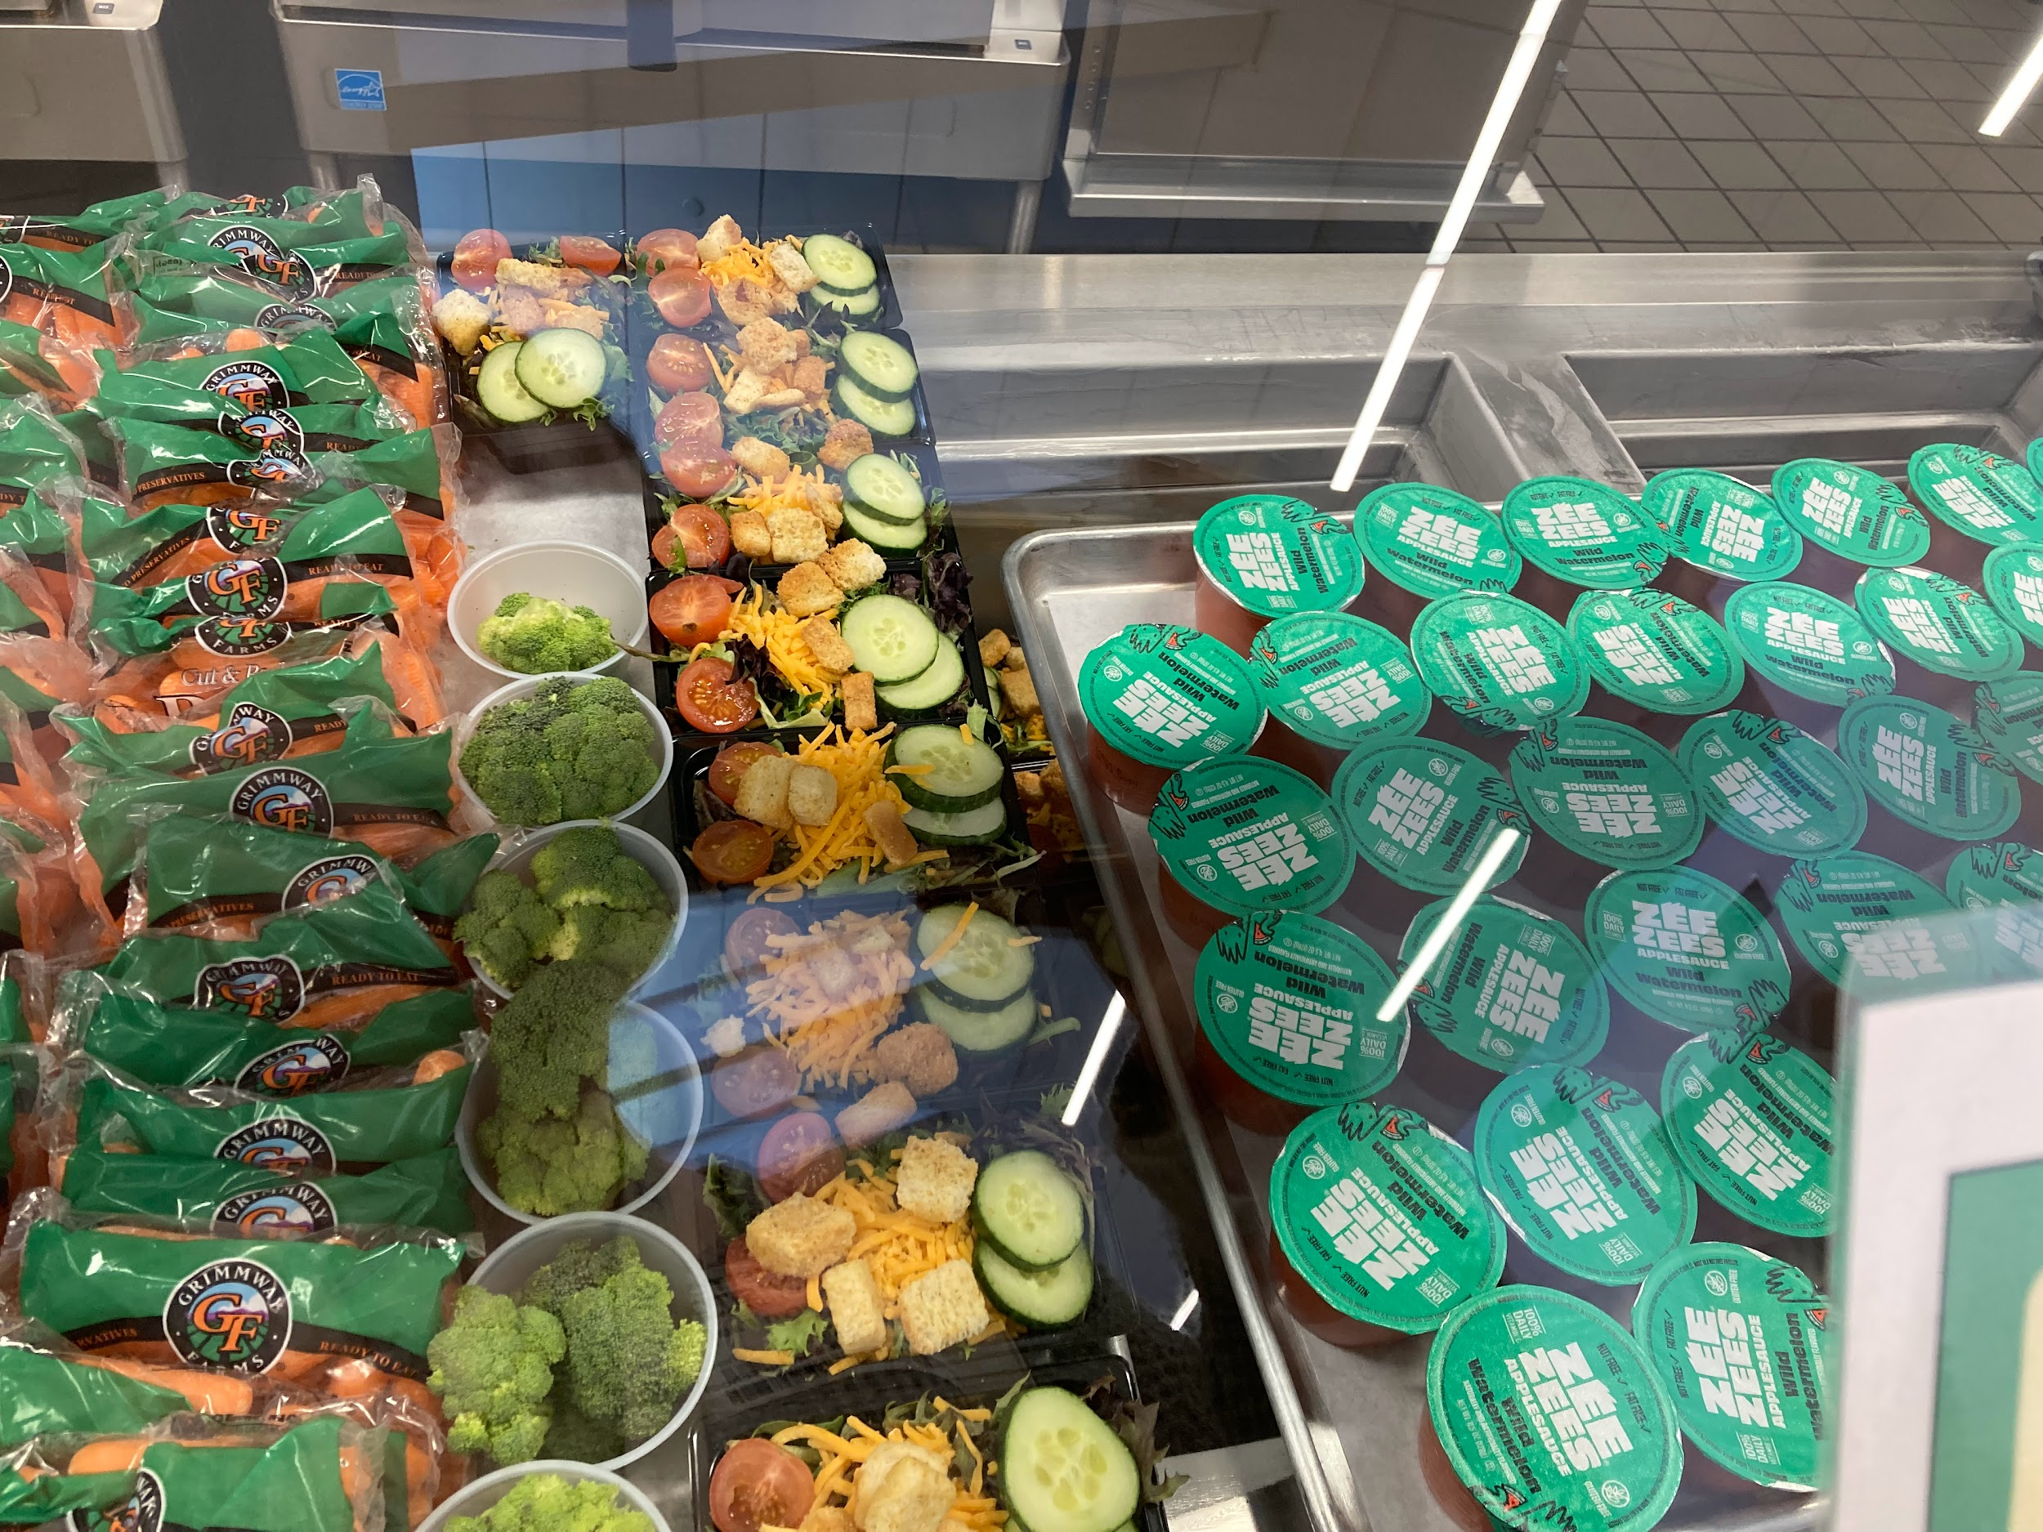
3. Improve Visibility
Variety increases total amount of items selected
Make items front and center - keep items:
  Easy to see
  Easy to reach
Notes:
We know convenience is important, and once aspect of that is improving visibility which is our next principle.
Variety increases total amount of items selected
Ec. more vegetables available, even if it’s the same thing on two lines, the more vegetables will be selected.
Make items front and center - keep items:
Easy to see
Easy to reach
This is our default setting

Slide 21
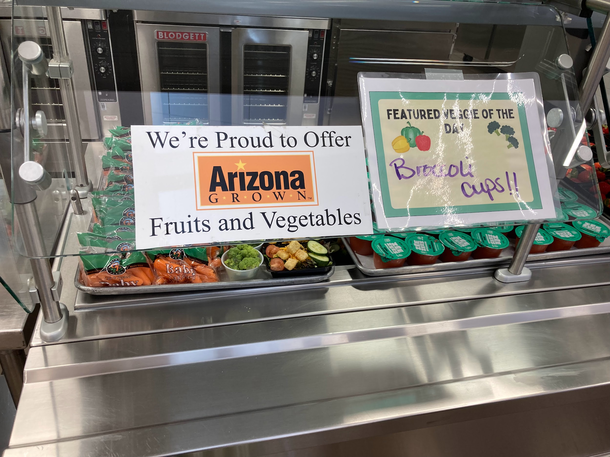
Improve Visibility, Cont.
Location is important!
The first line item has an 11% advantage when it comes to being selected.
Notes:
Furthermore -
Location is important!
The first line item has an 11% advantage when it comes to being selected.
If improving visibility improves the chance of an item being selected, try putting the featured entree first in line in the cafeteria!

Slide 22
Improve visibility by….
Placing foods at eye level
Place foods in multiple locations
List the most nutrient dense items first on the menus
Use eye catching details like bright colors, arrows, and pictures
Notes:
Here are some additional tips for improving visibility!
Placing foods at eye level
You might need to get creative, especially if you are a k-8 or k-12 school. Think about the size of a first grader versus an 8th or 12 grader!
Place foods in multiple locations
List the most nutrient dense items first on the menus
Use eye catching details like bright colors, arrows, and pictures

Slide 23
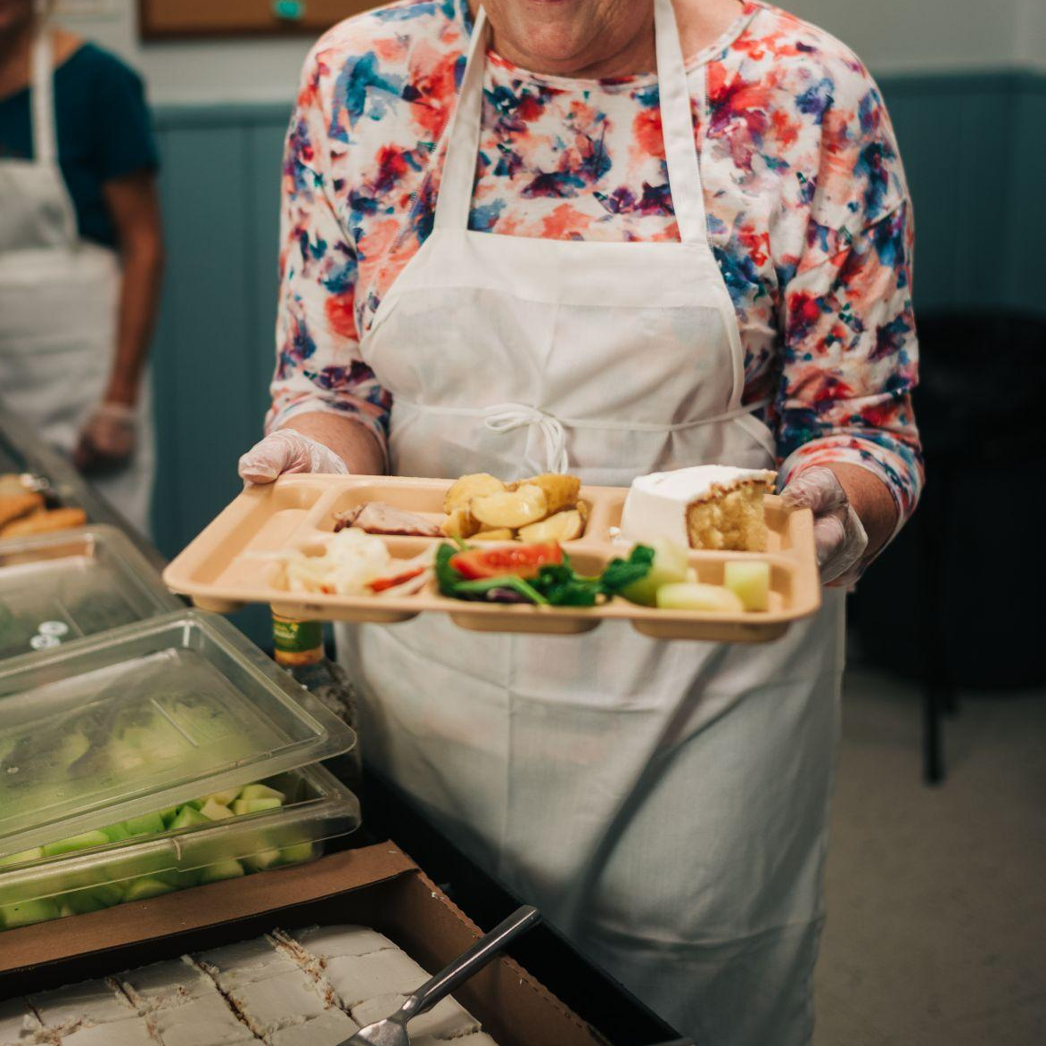
4. Enhance Taste Expectations
If it looks delicious and sounds delicious, it must be delicious
Name, appearance, and reputation create our expectations
Expectations dictate experience
Use descriptive naming and appealing labels to describe food
Great opportunity to engage students - create a contest for naming!

Slide 24
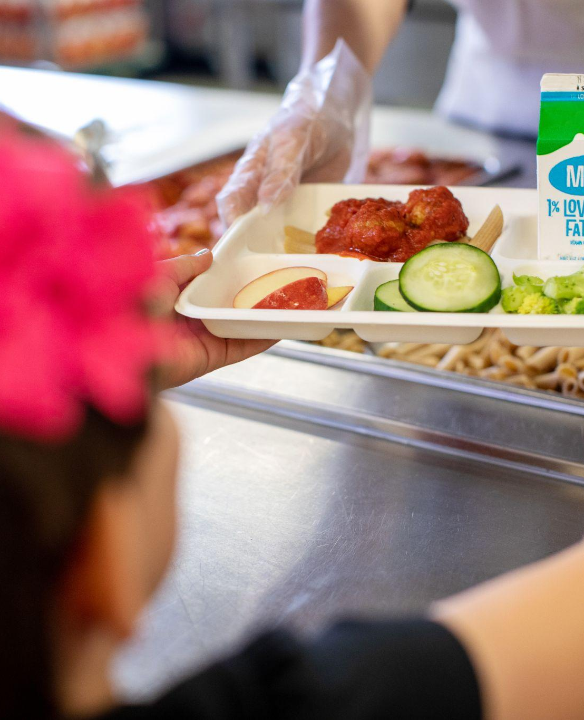
Menu
How can you make these lunch items sound more appealing?
Vegetable Lasagna
Salad
Whole Wheat Bread
Apple
Milk

Slide 25
Food Naming Ideas
Elementary Schools
Super Hero Spinach
Spicy Black Bean Bonanza
Tree Chompin’ Broccoli
Lean Mean Green Beans
Super Sweet Potato Wedges
Spuds Krazy Kale
Middle/High Schools
Immune Boosting Cabbage Shreds
Protein Packed Chickpeas
Vitamin Rich Baked Sweet Potato
Fresh Cucumber Chips
Powerhouse Kale
Sweet and Savory Glazed Carrots
Crispy Romaine
Notes:
Here are some additional food naming ideas:
Elementary Schools
Super Hero Spinach
Spicy Black Bean Bonanza
Tree Chompin’ Broccoli
Lean Mean Green Beans
Super Sweet Potato Wedges
Spuds Krazy Kale
Middle/High Schools
Immune Boosting Cabbage Shreds
Protein Packed Chickpeas
Vitamin Rich Baked Sweet Potato
Fresh Cucumber Chips
Powerhouse Kale
Sweet and Savory Glazed Carrots
Crispy Romaine

Slide 26
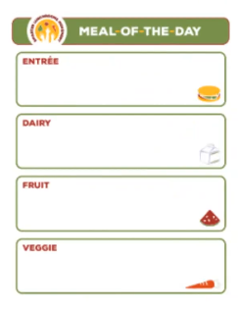
5. Use Suggestive Selling
Highlight the meal or items of the day on a menu board
Provide positive prompts such as:
  “Take an apple for later!”
  “Free milk with lunch today!”
  “Would you like some salad with that pizza?”
  “Fruit comes with your meal!”
Notes:
Next we are going to explore Suggestive Selling. With this principle, you can:
-highlight the meal or items of the day on a menu board
This menu board can be virtual or physical and be be available at multiple places in the cafeteria or school
-Provide positive prompts such as
“Take an apple for later!”
“Free milk with lunch today!”
“Would you like some salad with that pizza?”
“Fruit comes with your meal!”
These prompts can be verbal or or written, but the kindness of a food service staff might be extra convincing

Slide 27
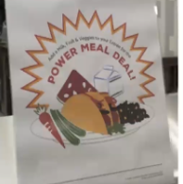
6. Set Smart Pricing Strategies
Bundling, especially reimbursable meals
  Ex. two-for-one on fresh produce
  Two-for-one on special marked items
Grab and go meals
Allow pre-ordering online
Notes:
Our final principle is: Set Smart Pricing Strategies
This may not hold as much value if you are at a school that offers free lunch to 100% of students, however, you can still use these strategies to nudge students to take more food.
Bundling, especially reimbursable meals
Ex. two-for-one on fresh produce
Two-for-one on special marked items
Grab and go meals
Allow pre-ordering online
Normally pre-ordering online is something parents might do for littles, but if you are working with middle and high school students, you may be able to give them the opportunity to pre-order lunch in one of their AM classes either online or with paper templates.
The smart pricing strategy is intended to increase the number of items sold, but especially increase the number of reimbursable meals sold.

Slide 28
Key Smarter Lunchrooms Lessons
Behavioral economics is the study of how the physical and social environment influences choice;
Most decisions about food are automatic or unthinking;
We often do not realize we are being influenced;
We can plan our eating spaces to ‘nudge’ us to make healthier choices;
Designing a choice to favor one option or another is choice architecture.
Don’t forget to apply your Trauma Informed lens!
Notes:
Let’s review some key Smarter Lunchrooms lessons
Behavioral economics is the study of how the physical and social environment influences choice;
Most of our decisions about food are automatic or unthinking and are largely influenced by the environment;
We often do not realize we are being influenced. We are particularly susceptible when we are in a “hot” state;
The good news: we can plan our eating spaces to ‘nudge’ us to make healthier choices;
Designing a choice to favor one option or another is choice architecture.
Don’t forget to apply your trauma informed lens when implementing this principles!

Slide 29
When to use Smarter Lunchrooms
Notes:
Now that you understand the research and principles behind the smarter lunchrooms movement, let’s talk about when to use this tool!

Slide 30
When to Use Smarter
Lunchrooms
Are you offering nutrition education classes at a school?
Are you supporting local wellness policy work for a district?
Are you supporting garden work at a school?
Has the staff, cafeteria manager, or administrators mentioned a desire to improve student nutrition, improve the ambience in the lunchroom, or boost the number of reimbursable meals sold?
If yes, it may be time to use Smarter Lunchrooms!

Slide 31
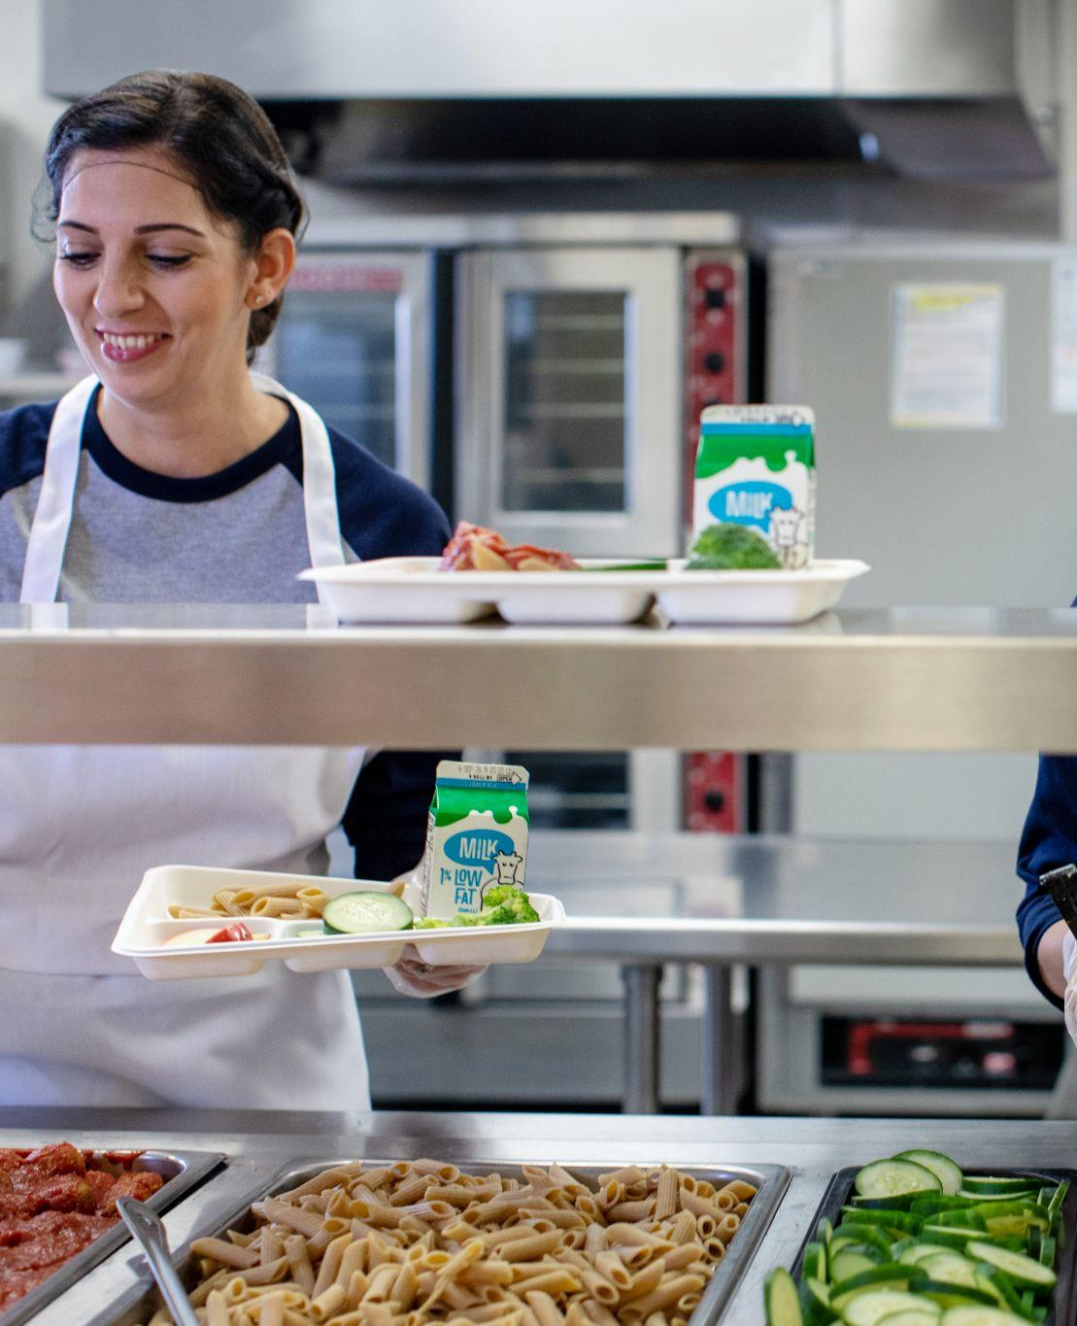
Selling Points of Smarter Lunchrooms
SLM is an evidence based intervention that can be used in schools
This is a tool meant to improve the lunchroom, via use of a scorecard.
You can provide SLM support to a district by supporting a district-wide training.
This is a tool that be used multiple times to improve the lunchroom.
The SLM can fall into all three categories of PSE change when integrated in the the school’s local wellness policy.

Slide 32
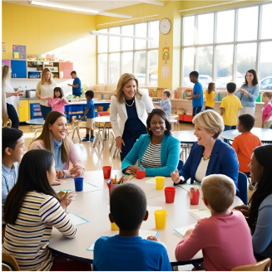
Tips for Using SLM
Engage the appropriate stakeholders including staff, students, parents, and the larger community from the very beginning;
Be mindful of what’s happening at the school;
Use your discretion in delivering results and recommendations
Notes:
Here are some tips for using the smarter lunchrooms movement
This is a highly collaborative process - make sure you are engaging the appropriate stakeholders including staff, students, parents, and the larger community from the very beginning;
Be mindful of what’s happening at the school; if the cafeteria is under stress from the triennial assessment, a finding or correction from the Arizona Department of Education, or some other situation, it may not be a good time to start the SLM or deliver results from the scorecard.
Use your discretion in delivering results and recommendations based on the resources and culture of the school. Take a trauma aware approach and adapt as necessary.

Slide 33
Local Implementing
Agency Role
Notes:
Now - if you are taking this training it means you belong to an AZ Health Zone local implementing agency. Let’s talk about your role in the Smarter Lunchrooms Movement

Slide 34
The LIA’s Role
Educator
  Educate stakeholders on the Smarter Lunchrooms Movement;
  Provide ideas for how students, the wellness committee, and community can get involved.
Convener
  Convene stakeholders to complete the Smarter Lunchrooms Movement;
  Convene and train stakeholders for sustainability;
  Convene the wellness committee to write the use of the Smarter Lunchrooms Movement into the local wellness policy.
Notes:
You have two primary roles when it comes to the smarter lunchrooms movement
The first is to act as an educator. This includes:
cator
Educate stakeholders on what Smarter Lunchrooms Movement is, how to use the tool and cycle of change
Provide ideas for how students, the wellness committee, and community can get involved
Your second role is that of a Convener
Convene stakeholders to complete the Smarter Lunchrooms Movement cycle of change
Convene the district schools, community members and other partners for trainings for sustainability
Convene the wellness committee to write the use of the Smarter Lunchrooms Movement into the local wellness policy
Acting as a convener and educator does not mean you do not complete the scorecard yourself- you do, but it’s important to realize your role is more than completing the scorecard - it’s about creating and supporting a culture of health in the lunchroom which takes a massive team. For the work we do as AZ Health Zone to be sustainable and thrive for years to come, we need to convene and educate others who are passionate about this work so it can continue to thrive without relying on us.

Slide 35
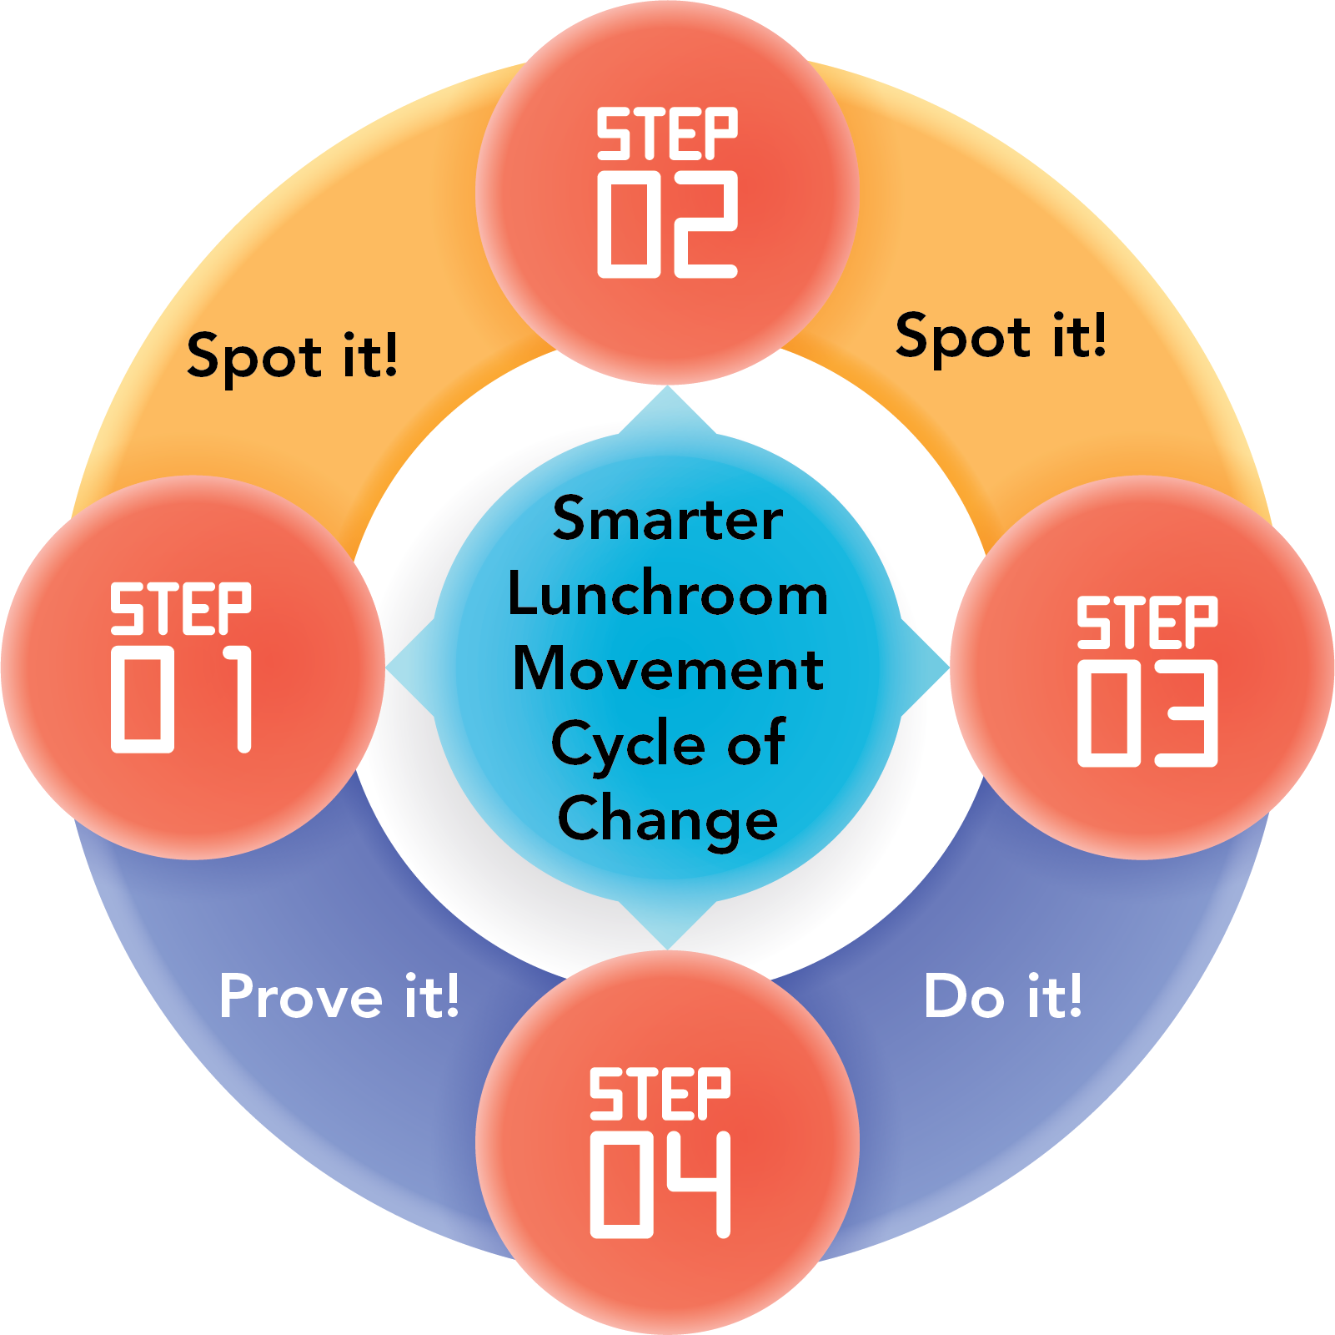
Smarter Lunchrooms Movement Cycle of Change
Notes:
As I’ve mentioned, the smarter lunchrooms movement is a cycle of change with four steps, spot it, plan it, do, prove it!

Slide 36
Spot it!
Don’t forget! If you plan on using the scorecard, it should be in your Community Project Plan and Evaluation Plan! Contact your SIT and SET Liaisons for support.
This is when you first complete the SLM Scorecard!
You will be trained on the scorecard use in the Part 2 training from the State Evaluation Team! Access to that training will be granted after completing today’s training.
Notes:
Step 1., Spot it
This is when you first complete the SLM Scorecard!
You will be trained on the scorecard use in the Part 2 training from the State Evaluation Team! Access to that training will be granted after completing today’s training.
Don’t forget! If you plan on using the scorecard, it should be in your Community Project Plan and Evaluation Plan! Contact your SIT and SET Liaisons for support.

Slide 37
2. Plan It!
Discuss opportunities for improvement in the lunchroom based off of scorecard results, the SET’s trauma informed recommendations, or other ideas from stakeholders;
In discussions with stakeholders, identify priorities, resources, timelines, tasks, and determine responsibility;
Use the Smarter Lunchrooms Movement Action Planning tool to guide your discussion and planning! This tool is available in English, Spanish, and Dine.
Notes:
You’ve completed the scorecard and found areas for improvement in the lunchroom, now it’s time to plan changes!
In step 2. Plan it! You discuss opportunities for improvement in the lunchroom based off of your scorecard results, the SET’s trauma informed recommendations, or other ideas from stakeholders.
In discussions with your lunchroom stakeholder group (those who completed the scorecard with you, the school food manager, or other personnel in charge) you’ll identify priorities, resources, timelines, tasks, and determine responsibility.
Use the Smarter Lunchrooms Movement Action Planning tool to guide your discussion and planning! This tool is available in English, Spanish, and Dine.
Use of the action planning tool is optional, but you may find it helpful. You can access this tool on the collaborator’s page.

Slide 38
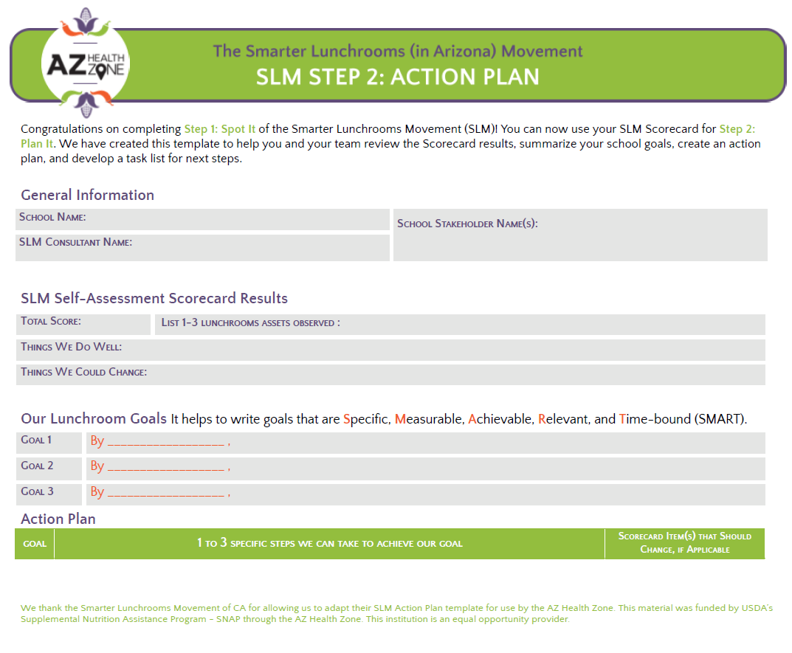
Notes:
Here, you can see page one of the action planning tool. This was developed specifically by AZ Health Zone to support the planning component of the Will soon be available in Dine and Spanish.

Slide 39
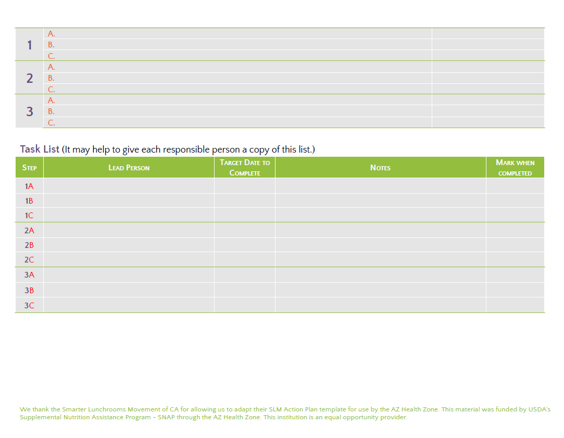
Notes:
This is the second page of the action planning tool, where you can break down of the smarter lunchroom goals you have set for yourself. For each subgoal, you can identify a lead person, a due date, and notes. Then, you can mark each task or subgoal as “complete” when finished!

Slide 40
3. Do It!
You can only be successful with support from the school community!
Make the changes from your action plan, and think about….
Timing: How will the change impact the school’s ability to serve lunch?
Engagement: Who needs to be involved in each change?
Tracking: What reminders should be sent? What photos should be taken?
Notes:
Step 3. Do it! Is all about implementing the ideas from Step 2. Plan it! Review your action planning worksheet if you used one, and think about the following items -
Timing: How will the change impact the school’s ability to serve lunch?
Engagement: Who needs to be involved in implementing each change?
Tracking: What reminders should be sent? What photos should be taken?
Remember, you can only be successful with support from the school community!

Slide 41
4. Prove it!
Now that your school has implemented some changes, it’s time to prove they’ve stuck! Gather your original group from Step 1. Spot it! to reassess the lunchroom.
Keep in mind this cycle of change could occur over a period of time as short as two months, or it could take over year! It all depends on the schedule of your school, and how many change they would like to implement.
Notes:
Step 4. Prove it! Now that your school has implemented some changes, it’s time to prove they’ve stuck! Gather you original group from Step 1. Spot it! To reassess the lunchroom.
Keep in mind that the Smarter Lunchrooms Cycle of Change can be implemented in a time as short as two months, or it could take over a year! It all depends on the schedule of your school and how many changes they would like to implement.

Slide 42
Technical Assistance
The State Implementation Team can support you with:
Step 2. Plan it!
Step 3. Do it!
The State Evaluation Team can support you with:
Step 1. Spot it!
Step 4. Prove it!
Notes:
The AZ Health State Team is available to provide technical assistance and support to you as needed with all aspects of the Smarter Lunchrooms Movement.
The State Implementation Team can support you with Step 2. Plan it! And Step 3. Do it! - the planning and implementation steps.
The State evaluation team can support you with Step 1. Spot it! And Step 4. Prove it! The evaluation steps.

Slide 43
Smarter Lunchrooms
and
AZ Health Zone
Principles
Notes:
Now we are going to review how to further integrate the AZ Health Zone Principles into the Smarter Lunchrooms movement.

Slide 44
The SLM Spectrum for Community Engagement
Empower
Community Message: Let’s unlock collective capacity for transformative solutions.
LIA staff provide as-needed support to school stakeholders who complete the pre Scorecard, plan and act, and complete the post Scorecard. LIA staff enter the data online.
Collaborate
Community Message: Your leadership and expertise are critical to address this issue.
LIA Staff guide school stakeholders to co-complete the pre Scorecard, plan and act, and co-complete the post Scorecard. LIA staff enter the data online.
Involve
Community Message: You are making us think differently about the issue.
LIA staff complete the pre-and post-Scorecards, and enter the data online. They work with school stakeholders to plan and act based on the Scorecard findings.
Notes:
The AZ Health Zone created a specific spectrum for the integration of community engagement in the Smarter Lunchrooms Movement.
The baseline level of engagement you should use when implementing the smarter lunchrooms movement is “involve”.The community message with this level of engagement is, “ You are making us think different about the issue.”
In the involve stage, LIA staff will complete the pre-and post-scorecards, and enter the data online. They work with school stakeholders to plan and act based on the scorecard findings.
The next level of engagement is collaborate. The community message is, “ You leadership and expertise are critical to address this issue.”
In the collaboration phase, LIA staff guide school stakeholders to co-complete the pre scorecard, plan and act, and co-complete the post scorecard. LIA staff enter the data online.
In the final stage of community engagement, we reach Empower. The community message is, “Let’s unlock collective capacity for transformative solutions.”
LIA staff provide as-needed support to school stakeholders who complete the pre-scorecard, plan and act, and complete the post scorecard. LIA staff enter the data online.

Slide 45
Empower
Students lead SLM
Families & school staff or wellness teams lead SLM
School leader leads SLM
Involve
Families and/or students also involved
School staff/wellness team involved
School leader (ex., cafeteria manager) involved
Collaborate
Families and/or students also collaborate
School staff/wellness team collaborates
School leader collaborate
Notes:
Short activity: Thinking about the different levels of community engagement, where do you think each category falls on a spectrum from “less engaged” to “most engaged”?
Drag and drop your answers by the arrow!

Slide 46
Trauma Informed Approaches
Taking a trauma informed approach with Smarter Lunchrooms can manifest in a few different ways:
  Changing language and examples to meet the population you are working with;
  While initially interested in SLM, some sites may be cautious to proceed with making changes, for a variety of reasons. Being open to changes and having respectful communication are great ways to build trust and allow for this work to continue in the future;
  Integrate guiding principles and effective messaging strategies from the Language of Health when talking about SLM principles/strategies, and health messaging.
Notes:
Let’s review our next AZ Health Zone Principle within Smarter Lunchrooms - Trauma informed approaches!
As AZ Health Zone local implementing agency staff, it’s important to take a trauma informed approach to all of your work, including Smarter Lunchrooms
Taking a trauma informed approach with Smarter Lunchrooms can manifest in a few different ways:
Changing language and examples to meet the population you are working with. Just like 1st graders need different sized serving utensils than 9th graders, you should provide recommendations and use language that are appropriate for your sight partner based on available resources.
While initially interested in SLM, some sites may be cautious to proceed with making changes, for a variety of reasons. Its okay to pause or change course if they are not ready to invest in the cycle of change. Being open to changes and having respectful communication are great ways to build trust and allow for this work to continue in the future.
Integrate guiding principles and effective messaging strategies from the Language of Health when talking about SLM principles/strategies, and health messaging. Smarter Lunchrooms is not inherently trauma informed, and it’s important to provide an AZ Health Zone lens during the planning and implementation of SLM.

Slide 47
No Time To Train
Notes:
Now - we will learn about No Time to Train, a staff development training for lunchroom staff, inspired by the Smarter Lunchrooms Movement!

Slide 48
No Time To Train
A year of 10-minute workshops for lunchroom that staff align with the USDA’s Professional Standards for School Nutrition Professionals;
No Time To Train (NTTT) follows and reinforces SLM principles to nudge students to make healthier choices in the lunchroom;
A set of 8 powerpoints are available in English and Spanish for group facilitation by LIA staff;
  Also available as a self-paced course for staff to complete at their leisure
Notes:
No Time to Train is a professional development training in the form of 10-minute workshops for lunchroom staff that align with the USDA’s Professional standards for school nutrition professionals.
Not time to train follows and reinforces the SLM principles to nudge students to make healthier choices in the lunchroom;
A set of 8 powerpoints are available in English and Spanish for group facilitation by LIA staff, but also available as self-paced courses for staff to complete at their leisure.

Slide 49
You have completed the Smarter Lunchrooms Movement Part 1 Training!
Please complete the Smarter Lunchrooms Movement Part 2 Training, created by the State Evaluation Team.
Once both trainings have been completed, you are a certified Smarter Lunchrooms Movement Consultant, and your certification is valid for the 2026-2030 AZ Health Zone grant cycle.
You can find SLM resources on the Collaborators page of the AZ Health Zone website.
For Smarter Lunchrooms Movement technical assistance and support, please reach out to the AZ Health Zone Youth and Adolescent Systems Specialist.
Notes:
Congratulations!
You have completed the Smarter Lunchrooms Movement Part 1 Training!
Please complete the Smarter Lunchrooms Movement Part 2 Training, created by the State Evaluation Team.
Once both trainings have been completed, you are a certified Smarter Lunchrooms Movement Consultant, and your certification is valid for the 2026-2030 AZ Health Zone grant cycle.
You can find SLM resources on the Collaborators page of the AZ Health Zone website.
For Smarter Lunchrooms Movement technical assistance and support, please reach out to the AZ Health Zone Youth and Adolescent Systems Specialist.

