Slide 1


Implementation Training
Fiscal Year 2026-2030
This material was funded by USDA’s Supplemental Nutrition Assistance Program - SNAP through the AZ Health Zone.
This institution is an equal opportunity provider.
Notes:
Welcome to the AZ Health Zone’s DIG in Schools Part 1 Training! This is the first of a two part training that will satisfy requirements to be an official DIG in Schools Consultant for the FY26-30 Grant Cycle.

Slide 2
Agenda
What is DIG In Schools
When you should use DIG in Schools
The LIA’s Role
Step 2. Sow
Step 3. Grow
Community Engagement
Notes:
Let’s review the training agenda:
What is DIG In Schools
When you should use DIG in Schools
The LIA’s Role
Step 2. Sow
Step 3. Grow
Community Engagement

Slide 3
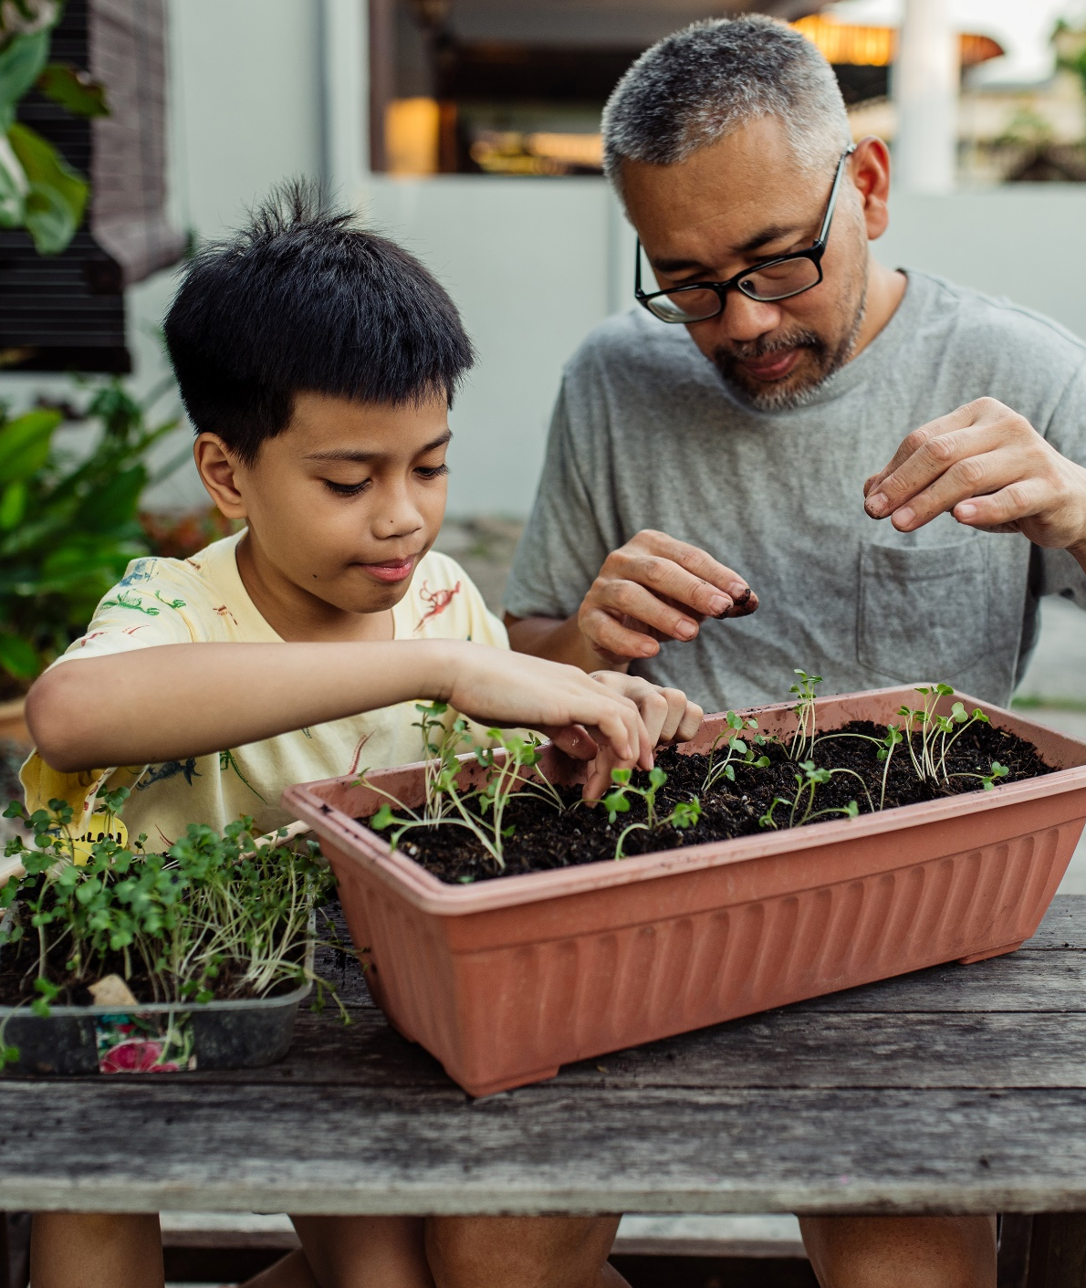
What is DIG in Schools?
Developing Integrated Gardens in Schools
4-step cycle of change to help schools grow and sustain their garden programs.
The DIG in Schools tool has 50 items, or ideas, for integrating the garden more fully into the school community.
Notes:
So what is DIG in Schools?
[1] "DIG" stands for "Developing Integrated Gardens.“ We'll talk about what "integrated" means in the next slide.
[2] We developed DIG in Schools as a four-step cycle of change to help schools grow and sustain their garden programs.
[3] The first and last step involve rating the school’s garden program using the DIG in Schools tool. As you’ll see, this tool includes 50 items, organized into four sections. Each item is an idea for how to integrate the garden more fully into the school community.
The goal with DIG in Schools is to use the tool to select ideas to work on that make sense for your school partner. You’ll also be able to track the garden's growth over time.

Slide 4
A Well-Integrated School Garden
“is a maintained garden at or near a school, is primarily used as a learning environment to create meaningful experiences for students, is a valued part of the school's culture, and is sustained over time."
Gardner Burt K, Koch PA, Contento IR. (2017) Development of the GREEN (Garden Resources, Education, and Environment Nexus) Tool: An Evidence-Based Model for School Garden Integration. J Acad Nutr Diet, 117:1517-1527.
Notes:
When we talk about a “well-integrated school garden,” we’re focused on the ways in which the garden is a part of the school’s everyday operations and identity. So, a well-integrated school garden is maintained at or near a school, primarily used as a learning environment, is a valued part of the school's culture, and is sustained over time.
Later, you’ll see that each of the four sections in the DIG in Schools tool address each element of this definition. For example, the Student Experience section includes ideas for how to create meaningful opportunities for students.

Slide 5
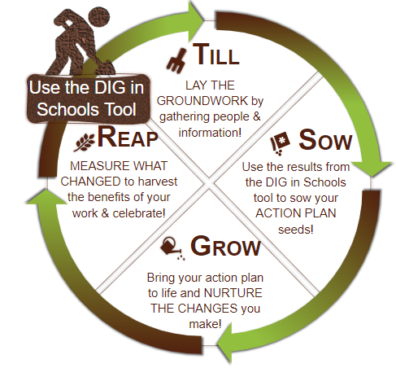

The DIG in Schools Cycle of Change
Let it be gnome that the SET can support you in completing the DIG in Schools tool during TILL and REAP!
The SIT can support your efforts to recruit and engage schools, action plan, and nurture the changes from your action plan!
Notes:
The DIG Cycle of Change assessment is composed of four categories - Till Sow, Grow, and Reap.
Till lays the groundwork by gathering people and information
Sow uses the results from the DIG in schools tool to sow your action plan seeds
Grow brings your action plan to life and nurtures the changes you make
Reap measures what changed to harvest the benefits of your work and celebrate!
For the purpose of this training on implementation, we will focus on the Sow and Grow sections.
Evaluation training and efforts focus on the Till and Reap cycles of this work

Slide 6
SIT
SET
DIG in Schools Part 1 Training
DIG In Action Planning Tool
Community Engagement Support
DIG In Schools Part 2 Training
DIG in Schools Rating Guide
DIG in School Consultant Guide
Let it be gnome that downloading the DIG in Schools Consultant Guide right now can save you time in the future!
Notes:
Take BOTH trainings to become a certified DIG In Consultant! Once you are a certified consultant, you can start using the DIG In Tool at your school.
The State Implementation Team, also known as the SIT, provides you with the part one training, the DIG in action planning tool which we will cover later, and community engagement support. The State Evaluation team, known as the SET, provides you the part two training which covers use of the tool, the DIG in school rating guide, and the consultant guide. Feel free to download the linked documents now.

Slide 7
Describe DIG in Schools
DIG In Schools is a four-step cycle of change that includes a tool to evaluate the school garden program. This tool looks at four components of gardens:
Resources and Support;
The Garden;
Student Experience; and
Culture and Community
These are the components that define a well-integrated garden.
Notes:
DIG In Schools is a four-step cycle of change that includes a tool to evaluate the school garden program. This tool looks at four components of gardens:
Resources and Support;
The Garden;
Student Experience; and
Culture and Community
These are the components that define a well-integrated garden.

Slide 8
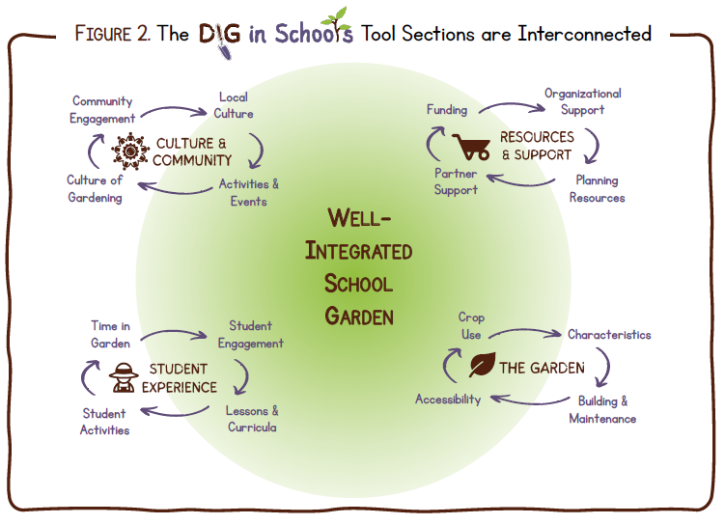
Notes:
As mentioned earlier, we will will be reviewing how to SOW and GROW the within the four different components of of Designing a Well Integrated School Garden. The four Sections are:
Resources and support, which includes organizational support, planning and resources, partner support, and funding;
The Garden, which includes characteristics, building and maintenance, accessibility, and crop use;
Student Experience, which covers student engagement, lessons and curricula, student activities, and time in the garden; and
Culture and Community, which covers local culture, activities and events, culture of gardening, and community engagement.
Within the this tool, some high-priority items for gardening have been identified in each section.The majority of this section will focus on those high-priority items.

Slide 9
What Does DIG In Schools Accomplish?
Schools will know where their garden program strengths and opportunities for improvement are.
Identify areas of garden program work they would like to focus on to improve the integration of their garden program.
After implementing changes, schools can use the tool again and see their improvements.
Schools can use the tool to create a baseline for improvement, or as guide to start their garden work.
Notes:
What does DIG in Schools Accomplish?
After completing the DIG In tool, schools will:
know where their garden program strengths and opportunities for improvement are.
After initial tool use, the school, or garden champion, can identify areas of garden program work they would like to focus on to improve the integration of their garden program. This is where you can use the DIG In Action Planning Tool.
After implementing changes, schools can use the tool again and see their improvements.
Schools can use the tool to create a baseline for improvement, or as guide to start their garden work.
In short - DIG In Schools creates a cycles of change, with flexible ways to improve school garden programs.

Slide 10
Additional Benefits of DIG In Schools…
Opportunities to collaborate with garden partners.
Meets your site where they are at in garden work!
Serves as a guide to keep garden flourishing.
Provides flexibility for the site to choose what they want to focus on.
Tracks progress and celebrate the fruits of your site’s labor!
Notes:
Additional benefits of using the DIG in Schools tool includes…
Opportunities to collaborate with garden partners.
Meets your site where they are at in garden work!
Serves as a guide to keep garden flourishing.
Provides flexibility for the site to choose what they want to focus on.
Tracks progress and celebrate the fruits of your site’s labor!

Slide 11
When should you use
DIG In Schools?
Notes:
When you should you use DIG in Schools? Let’s find out!

Slide 12
When Should You Use DIG In Schools?
Does your community project plan includes school garden work?
Do you have established partnerships with schools that want to improve their garden?
If you have educated your school partners on DIG in Schools, have they voiced interest?
If yes to any of the above, it might be time to use DIG in Schools!
Notes:
Ask yourself the following questions to see if you should use DIG in Schools:
Does your community project plan includes school garden work?
Do you have established relationships with schools that want to improve their garden?
If you have educated your school partners on DIG in Schools, have they voiced interest in the tool?
If yes to any of the above, it might be time to use DIG in Schools! If you haven’t brought up this tool with your school partners, now would be a great time to do so!

Slide 13
Why is DIG in Schools right for your school?
Are you working with a school that has a garden?
    If yes, ask them about their garden goals!
Are you working with a school that has no garden?
    If yes, ask them if they want to start a school garden!
Notes:
Now that you know when you should use DIG in schools, you need to know why it’s right for your school! Think about it…
Are you working with a school that has a garden?
If so, ask questions about their garden goals, where they are on their journey, and if this an area where they would like support. If they would like support, tell them about the DIG In Schools and get collaboratin’!
Are you working with a school that has no garden?
If so, ask them if they are interested in starting a school garden if they haven’t previously indicated an interest/capacity. Tell them about the benefits of a school garden, and how you can support them. You can use the DIG In Schools tool or the DIG in Schools Garden Program Guide to identify garden program priorities and create a foundation for the school’s garden program.

Slide 14
Local Implementing Agency Role
Notes:
Let’s explore the role and duties of local implementing agency staff in DIG in Schools.

Slide 15
What role do LIAs play in DIG?
Introducing and educating schools on DIG In Schools;
Convening students, staff, administrators, caretakers, community members to complete the DIG In Schools Cycle of Change;
Connecting site partners to community partners, and other relevant resources;
Supporting internal capacity building for continuation of garden-based work; and
Supporting community engagement efforts between the school, students and families
Notes:
Local Implementing Agency, or LIA, staff, play a very large role in DIG in Schools! LIAs are responsible for:
Introducing and educating schools on DIG In Schools;
Convening students, staff, administrators, caretakers, community members and other relevant stakeholders to complete the DIG In Schools Cycle of Change;
Connecting site partners to community partners, and other relevant resources;
Supporting internal capacity building for continuation of garden-based work; and
Supporting community engagement efforts between the school, students and families
Overall, the role of the LIA is very important! In role your as a consultant, not only do you educate on how to use the tool and make changes by acting as a convener and facilitator, by helping foster relationships with other important stakeholders and

Slide 16
Step 2. SOW
Notes:
Now it’s time to review how we will sow our seeds for success with Step. 2 of the dig in schools cycle of change - Sow!

Slide 17
Step 2. Sow
Received trauma informed recommendations from SET;
Convene original group that used or supported Step 1;
Review review tool items, score, and recommendations;
Ask interested parties what goals they would like to focus on, and fill in the DIG In Action Planning Tool.
Notes:
Step 2. SOW starts after you have completed step 1. Till.
You can start this process after you receive your trauma informed recommendations from the SET, or you can dive in immediately after till if there are items your school partners know they want to work on.
Convene your DIG in group and review the items and goals from the DIG in tool, your score, and trauma informed recommendations as a team
Ask the group and interested parties what goals they would like to create and focus on. This is where you can use the optional DIG in Action Planning tool.
This tool can support both DIG in Community, and DIG In Schools.

Slide 18
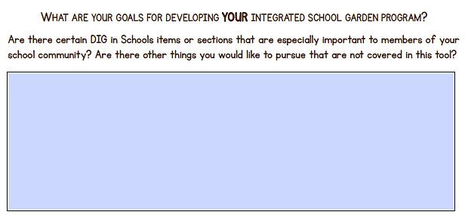
Notes:
This is the goal section from the DIG in Schools tool. Make sure to review this with your team before using the action planning tool - you want to remember to plan for all of your goals!

Slide 19
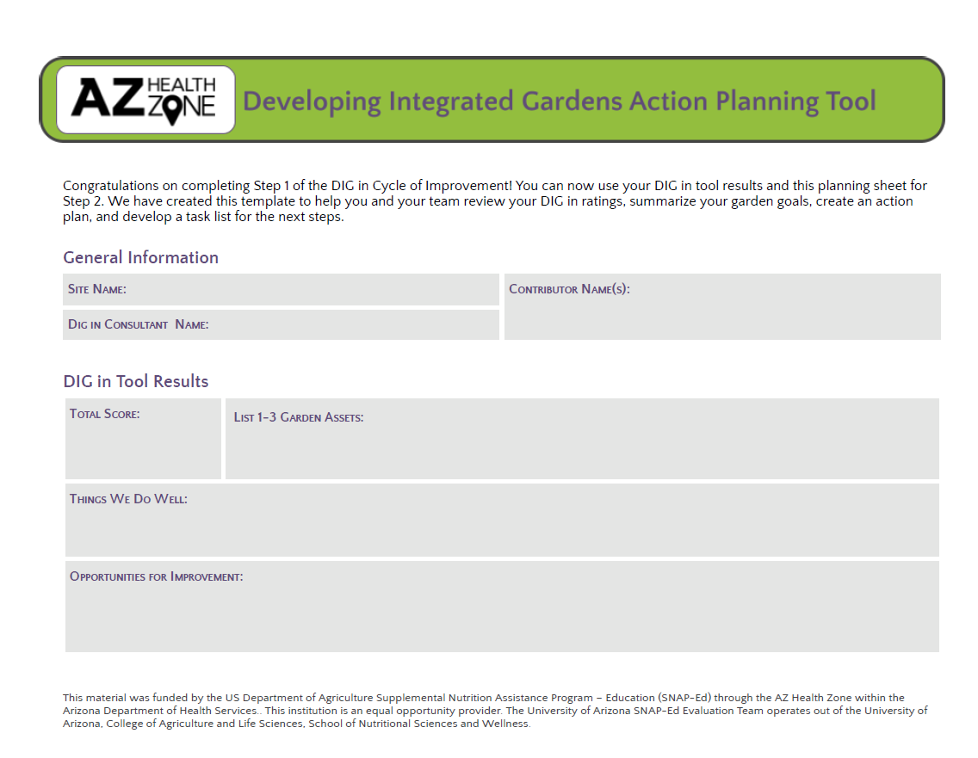
Notes:
This is page one of the DIG In action planning tool which can found on the AZ Health Zone Collaborators Page. This tool can support both DIG in schools and community, and is available in English, Spanish, and Dine.
This optional action planning tool collects basic information about you and the site you are supporting, before collecting additional informational about your DIG in score, and assets for your site.

Slide 20
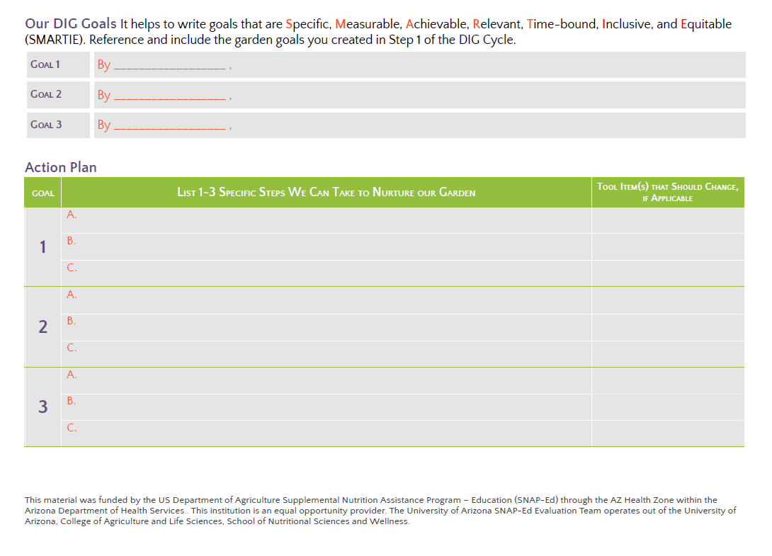
Notes:
On the second page of the DIG in Action Planning tool, you’ll list up to three goals. Don’t worry - if you have more than 3 goals you can print out or use a second worksheet. Make sure your goals follow SMART goal objectives - meaning they are specific, measurable, achievable, relevant and time bound. Extra points if these goals re inclusive and equitable!
Once you have your primary goals, you can break your goals down into specific tasks or subgoals.

Slide 21
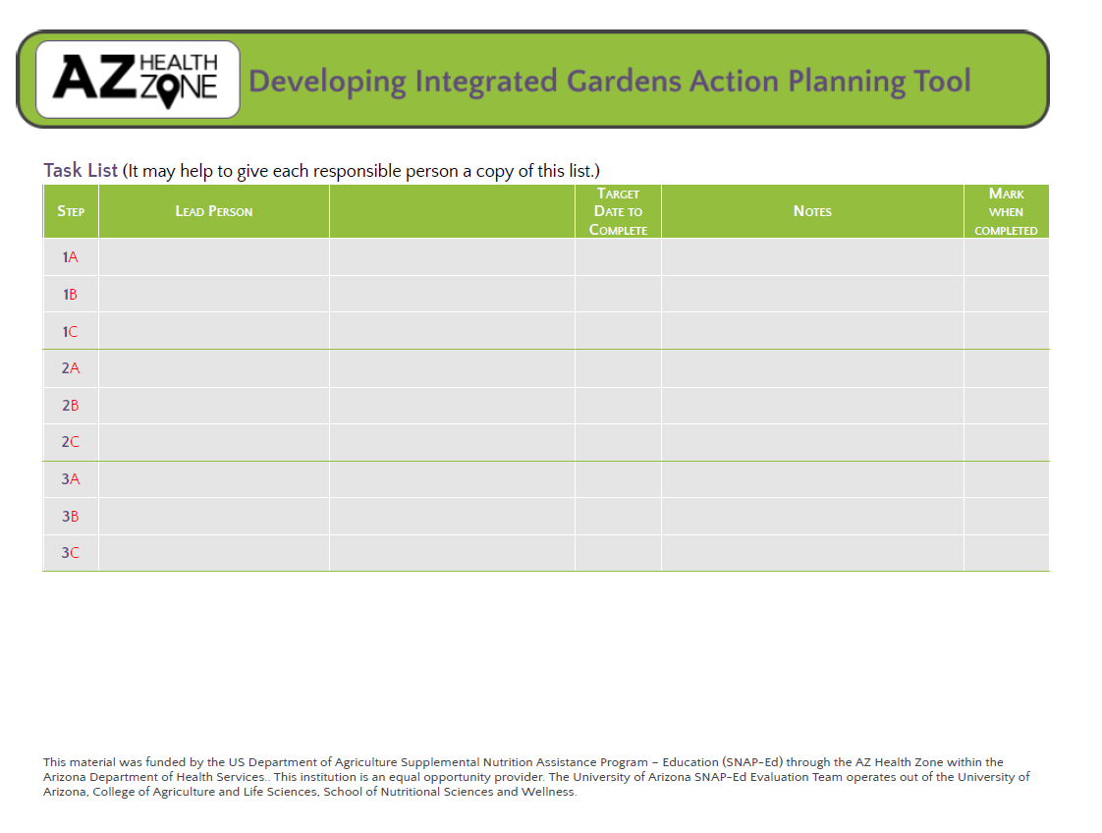
Notes:
On the third and final page of the action planning tool, you can assign specific parties to each task or goal, and put a completion date on each task. Remember, this tool is optional, but if you choose to use it, it should be co-completed with your site’s DIG in team. Additionally, as part of internal capacity building and ownership, you’ll want site partners to be responsible for some of the tasks and goals.

Slide 22
Step 3. GROW
Notes:
Now that we’ve reviewed planning, let’s discuss the implementation stage of DIg in Schools - Step 3. Grow! In this section, we will review high priority items within the tool.

Slide 23

Resources and Support
1.The school has at least one very active garden person, like a garden champion or designated leader.
!
LIA’s Role: Support school staff in identifying this person/people. Work with school administration to see if there may be additional compensation for this position.
!
2. The school has adequate information about how to fund garden program activities.
LIA’s Role: Facilitate conversations around items needed to start and maintain a garden, general costs, and take account of what items the school might already have.
Notes:
Let’s review how to support high priority items in the Resources and Support Section of the DIG in Schools Tool
1.The school has at least one very active garden person, like a garden champion or designated leader.
LIA’s Role: Support school staff in identifying this person/people. Assisting the school in creating a garden plan or advisory group may be helpful to get an idea of what the roles and responsibilities may be for this person. Work with school administration to see if there may be additional compensation for this position.
6.The school has adequate information about how to fund garden program activities.
LIA’s Role: Facilitate conversations around items needed to start and maintain a garden, general costs, and take account of what items the school might already have. Use the new budget sheet, and discuss potential donations and grants.

Slide 24
Resources and Support
!
8.The school administration provides staff with DEDICATED TIME for planning, implementing, and/or evaluating the school garden program (ex., building or tending the garden, teaching lessons).
LIA’s Role:
Create a garden advisory board or identify a garden champion;
Talk with administrators about dedicating instructional minutes toward gardening;
Support school staff in identifying curriculum;
Integrate garden related policies into the local wellness policy;
Talk with your school about the benefits of having a garden.
Notes:
8.The school administration provides staff with DEDICATED TIME for planning, implementing, and/or evaluating the school garden program (ex., building or tending the garden, teaching lessons).
LIA’s Role: You may be teaching, planning, and tending to the garden currently, but the goal is get staff involved and taking ownership.
Create a garden advisory board or identify a garden champion that can promote the work of the garden to the entire school;
Talk with administrators about dedicating instructional minutes toward gardening;
Support school staff in identifying curriculum they might use;
Integrate garden related policies into the local wellness policy;
Talk with your school about the benefits of having a garden.

Slide 25
Resources and Support
!
3.The school has a GARDEN PROGRAM GUIDE IN HARDCOPY AND/OR ELECTRONIC FORM that includes:
The garden program’s vision and goals
A budget plan for obtaining funding and supplies
The garden’s design/layout
The intended use(s) for the garden
A written garden maintenance plan
A written plan for integrating the garden into the student experience, integrating the garden into the broader school community, and a succession plan
Notes:
13.The school has a GARDEN PROGRAM GUIDE IN HARDCOPY AND/OR ELECTRONIC FORM that includes:
The garden program’s vision and goals
A budget plan for obtaining funding and supplies
The garden’s design/layout
The intended use(s) for the garden
A written garden maintenance plan
A written plan for integrating the garden into the student experience (ex., curricula, growing)A written plan for integrating the garden into the broader school community (ex., harvest events)A written succession plan to address turnover or handoffs of garden-related staff
LIA’s Role: Help educate your garden champions on all things garden programming, and complete the AZ Health Zone DIG In Schools Garden Program Planning Tool that meets the above requirements.

Slide 26
Resources and Support
LIA’s Role: Help educate your garden champions on all things garden programming, and complete the AZ Health Zone DIG In Schools Garden Program Template that meets the requirements of item 13 on the previous slide.
Notes:
LIA’s Role: Help educate your garden champions on all things garden programming, and complete the AZ Health Zone DIG In Schools Garden Program Template that meets the requirements of item 13 on the previous slide.

Slide 27
Resources and Support
USDA - Patrick Leahy Farm To School Program
USDA Farm To School Toolkit
Regional Food Business Center
Urban School Food Alliance
Farm to School Network
Arizona Farm to School Network
Kids Gardening
School Garden Support Organization Network
Whole Kids Foundation
Sprouts Healthy Community Foundation
Notes:
Here is a list of national and state organizations that can be of use to your school sites! Sign up for these newsletters, check for grants, attend webinars, and encourage your partners to subscribe to their email lists. This will support your internal capacity building work. Click to the links to visit each website.
Additionally, don’t forget to learn about your local, county and state government programs, 4-H and master gardener programs, local businesses, and organizations, as those can be great places to learn about additional resources.

Slide 28

The Garden
!
1.The school has at least one type of garden.
LIA’s Role: Help school decide what type of garden might be best for them based on their garden goals, resources, and funding.
!
2.The school has all of the tools and materials needed to build and/or maintain the garden.
LIA’s Role: Assess what materials the school has versus what they would need to create or upgrade their garden space.
Notes:
The high priority items in the Garden section of the DIG in Schools tool include….
1.The school has at least one type of garden (ex., raised bed, in ground, hydroponic, pollinator).
LIA’s Role: Help school decide what type of garden might be best for them based on their garden goals, resources, and funding. If now is not a good time for the school to start a garden, that’s fine. Continue garden work in the classroom, out of pots, or partner with a local farmer or another garden to organize field trips and experiential learning until the school has better capacity.
2.The school has all of the tools and materials needed to build and/or maintain the garden (ex., lumber,soil, shade cloth, shovels, hoses, any needed power supply, water source).
LIA’s Role: Based on the type of garden your school wants, assess what materials they have versus what they would need to create or upgrade their garden space. Look into grants or donations from stores to help meet the needs of the garden space and make sure the school is involved in the relationship building and grant application.

Slide 29
The Garden
!
3. The school has a suitable garden space for all intended use(s);
4. The garden area has enough lighting and shade for the intended use(s);
5. The watering system is suitable for the garden type;
6.The garden has sufficient drainage;
17.The garden space has been assessed for safety.
!
!
!
!
LIA’s Role: Provide resources, education, and technical support for garden.
Notes:
3. The school has a suitable garden space for all intended use(s), like growing and teaching;
4. The garden area has enough natural (or artificial) lighting and shade for the intended use(s);
5. The watering system is suitable for the garden type, school maintenance capacity, and school goals;
6.The garden has sufficient drainage. N/A (ex., hydroponic or flood crop);
17.The garden space has been assessed for safety, including child-safe pest control and tools, no vagrancy (ex. fencing prevents strangers from entering), and low risk of falling/slips;
LIA’s Role: Provide resources, education, and technical support for garden design and utilization of space, lighting and shade, watering systems and drainage, and safety measures.

Slide 30
The Garden
Garden purpose
Available physical space
Staff capacity for education and maintenance
Budget
Access to water and materials
Classroom sizes/number of students utilizing garden
Proximity to classrooms
Accessibility and ADA compliance
Use of local and cultural practices
Safety structures such as gates, walls, or fences
Notes:
Here are some additional items to think about when considering starting or updating a garden, or expanding your garden program:
Garden purpose
Available physical space
Staff capacity for education and maintenance
Budget
Access to water and materials
Classroom sizes/number of students utilizing garden
Proximity to classrooms
Accessibility and ADA compliance
Use of local and cultural practices
Safety structures such as gates, walls, or fences

Slide 31

Student Experience
!
2. Students help create and/or maintain some aspect of the PHYSICAL garden.
LIA’s Role: Conduct youth and adolescent minded engagement activities, or provide professional development and technical assistance to your site partners to conduct their own engagement activities.
Notes:
Now for the high priority questions in the Student Experience section of DIG In Schools…
2. Students help create and/or maintain some aspect of the PHYSICAL garden (ex., designing an eco-friendly garden, building beds, doing chores like watering or weeding) on a regular basis.
LIA’s Role: Conduct youth and adolescent minded engagement activities, or provide professional development and technical assistance to your site partners to conduct their own engagement activities. After learning student preferences, work with your school site staff (and students) to develop processes to involve students in garden creation and maintenance. This engagement will occur at the involve or collaborate level.

Slide 32
Student Experience
Time in Garden
Before/After School Access
Instructional Time and Open Periods
Lunch/Recess
Student Experience
Sensory time
Engagement in garden design and crop selection
Active role in till, sow, grow, reap activities
Lessons and Curricula
Core instruction/Local Wellness Policy support
Student Activities
Garden Club
Garden Advisory Board
Field trips to farms/other gardens
Notes:
Here are some items to consider when planning activities, policies or programming around the student experience:
Time in Garden
Before/After School Access
Instructional Time and Open Periods
Lunch/Recess
Student Experience
Sensory time
Engagement in garden design and crop selection
Active role in till, sow, grow, reap activities
Lessons and Curricula
Core instruction/Local Wellness Policy support
Student Activities
Garden Club
Garden Advisory Board
Field trips to farms/other gardens

Slide 33

Culture and Community
!
People from diverse groups like these participate in ongoing school garden activities:
•Classroom teachers and specialists
•School maintenance/facilities staff
•School or district administrators
•Other school staff
•Families of students
•Local volunteers
•Community partners
LIA’s Role: Initially, act as a convener to bring these groups together. Eventually, this group should convene regularly on their own.
Notes:
People from diverse groups like these participate in ongoing school garden activities
•Classroom teachers and specialists (ex., PE teacher, nurse)
•School maintenance/facilities staff
•School or district administrators
•Other school staff (ex., front desk, bus drivers)
•Families of students
•Local volunteers (ex., local gardeners, elders, church groups)
•Community partners (ex., tribal organizations, the AZ Health Zone, local businesses, AmeriCorps)
LIA’s Role: Initially, act as a convener to bring these groups together. You might organize a Garden Advisory Group that meets regularly to support school garden efforts. Eventually, this group should convene regularly on their own.

Slide 34
Culture and Community
Cultural Practices include:
Gardening design and maintenance practices
Use of specific tools
Crop selection and harvesting practices
Popular or meaningful meals
Celebrations or ceremonies
Cultural Practices can be based on:
Ethnicity
Tribal affiliation
Religion
Language
Geography
Notes:
Here are some things to keep in mind when thinking about cultural practices…
Culture Practices include:
Gardening design and maintenance practices
Use of specific tools
Crop selection and harvesting practices
Popular or meaningful meals
Celebrations or ceremonies
Cultural Practices can be based on:
Ethnicity
Tribal affiliation
Religion
Language
Geography

Slide 35
Community
Engagement
Notes:
Now that we have reviewed how to support implementation of high priority items, let’s learn about Community Engagement for DIG in Schools!

Slide 36
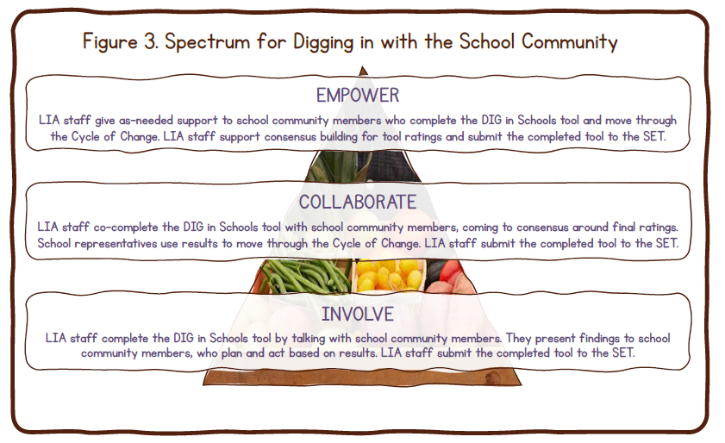
Notes:
The spectrum of community engagement for digging in with the school community has three stages - involve, collaborate, adn empower. If you’ve already take the smarter lunchrooms training, this will sound very similar.
At the INVOLVE level, the LIA Consultant completes the DIG in Schools tool, but you are still talking with school representatives to rate the items. You present the findings to the school, who plans and acts based on the results. This might be a good choice if the school wants an external person to rate their garden to get an outside perspective. Even so, the school should decide what changes they want to make.
At the COLLABORATE level, LIA staff co-complete the tool with school representatives, coming to consensus around the final ratings. The school uses the results to move through the Cycle of Change. This may be a popular choice, since it allows you to blend your expertise with the lived experiences and interests of your school community.
At the EMPOWER level, LIA staff give as-needed support to school representatives who complete the tool and move through the Cycle of Change. As a trained Consultant, it’s your job to facilitate group consensus building for the final item ratings. This might be a good choice if the school already has a knowledgeable garden group. It may also be a good choice for student-led projects, for example where high schoolers in a garden club are taught to use DIG in Schools.

Slide 37
Digging in with the School Community
Let it be gnome that the AZ Health Zone defines Community Engagement as directly engaging SNAP-eligible residents. When you report your DIG in Schools activities in SEEDS, please reserve Community Engagement for working directly with students, families, or resident volunteers.
Notes:
Community engagement and digging in with the school community is very important, because it provides an opportunity to receive feedback to residents of the areas where we live, work and play. Let it be gnome that the AZ Health Zone defines Community Engagement as directly engaging SNAP-eligible residents. When you report your DIG in Schools activities in SEEDS, please reserve Community Engagement for working directly with students, families, or resident volunteers.

Slide 38
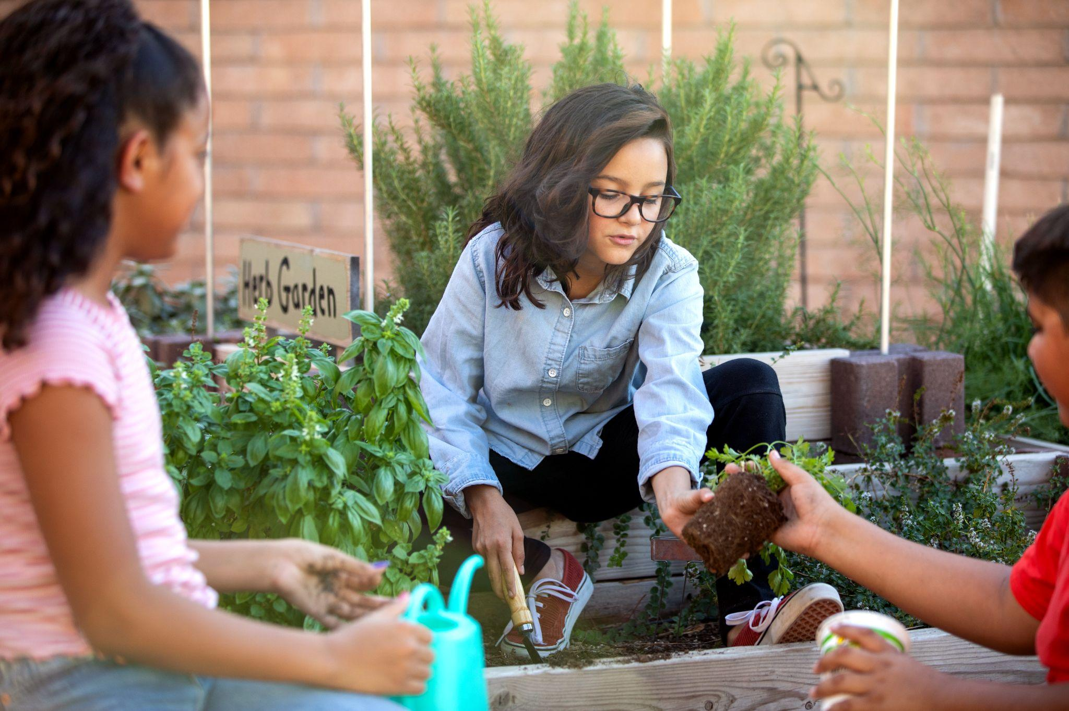
Congratulations!
You have completed the DIG In Schools Part 1 Training!
You may now take the DIG in Schools Part 2 Training.
You must complete both trainings and pass the certification quiz at the end of the part two training to become a DIG in Schools Consultant.
Questions? Please contact State Implementation Team!
Notes:
Congratulations!
You have completed the DIG In Schools Part 1 Training!
You may now take the DIG in Schools Part 2 Training.
You must complete both trainings and pass the certification quiz at the end of the part two training to become a DIG in Schools Consultant.
Questions? Please contact the state implementation team.

